Slide 1
Mobile-Commerce Development
Lesson
Google Firebase Realtime Database
Lecturer:
Tran Duy Thanh, Phd
Nguyen Quang Phuc, Msc
Email: thanhtd@uel.edu.vn
Blog: https://tranduythanh.com
Phone: 0987773061

Slide 2
Lesson Objective
Students know advantages of Firebase realtime Database
Create Firebase Account and Firebase realtime Database
Connect Android App to Firebase
Read List from Firebase Realtime Database
Insert Firebase Realtime Database
Read Single data from Firebase Realtime Database
Update Firebase Realtime Database
Delete Firebase Realtime Database
Details of the instruction: https://tranduythanh.com/category/firebase/

Slide 3
Outlines
Introduction Firebase Realtime Database
Connect App to Firebase
Add the Realtime Database to App
Create Realtime Database
Read List Firebase Realtime Database
Insert Firebase Realtime Database
Read Single data Firebase Realtime Database
Update Firebase Realtime Database
Delete Firebase Realtime Database

Slide 4
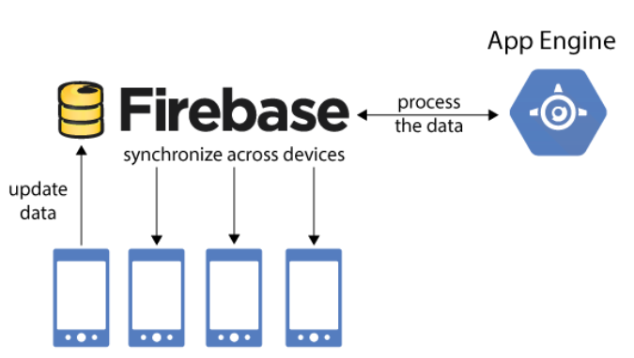
1. Introduction Firebase Realtime Database
The Firebase Realtime Database is a cloud-hosted database. Data is stored as JSON and synchronized in realtime to every connected client. When you build cross-platform apps with our Apple platforms, Android, and JavaScript SDKs, all of your clients share one Realtime Database instance and automatically receive updates with the newest data.
More Reading: https://firebase.google.com/docs/database
https://tranduythanh.com/2018/10/11/phat-trien-ung-dung-co-so-du-lieu-thoi-gian-thuc-voi-firebase-phan-1/
https://tranduythanh.com/2018/10/13/phat-trien-ung-dung-co-so-du-lieu-thoi-gian-thuc-voi-firebase-phan-2/
https://tranduythanh.com/2018/10/15/phat-trien-ung-dung-co-so-du-lieu-thoi-gian-thuc-voi-firebase-phan-3/
https://tranduythanh.com/2018/10/15/phat-trien-ung-dung-co-so-du-lieu-thoi-gian-thuc-voi-firebase-phan-4/
https://tranduythanh.com/2018/10/15/phat-trien-ung-dung-co-so-du-lieu-thoi-gian-thuc-voi-firebase-phan-5/

Slide 5
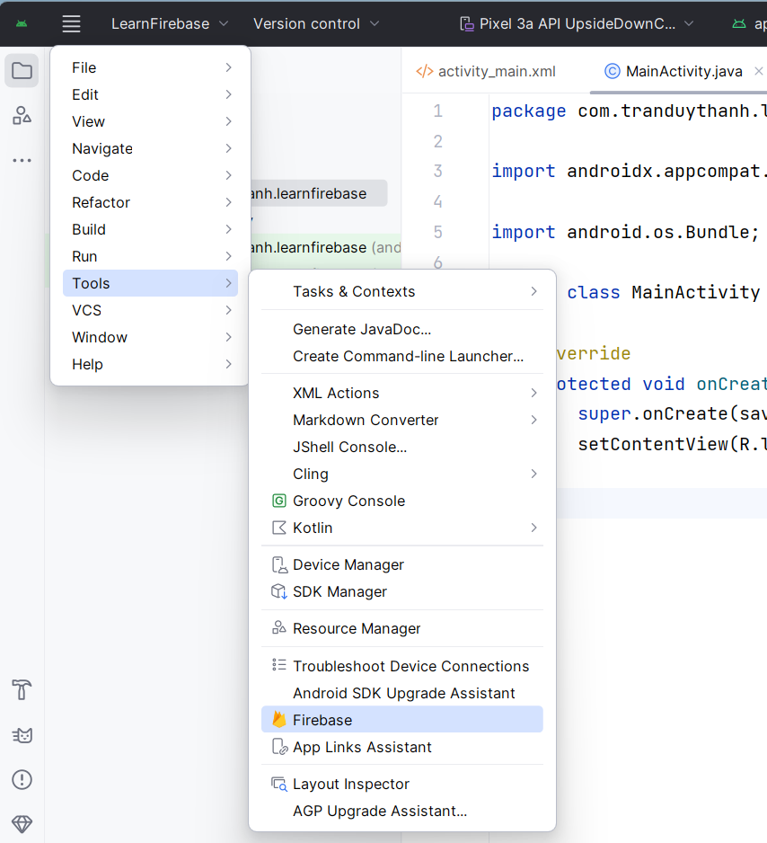
2. Connect App to Firebase
Create a Project in Android Studio with name “LearnFirebase”
Then go to Tools/select “Firebase”

Slide 6
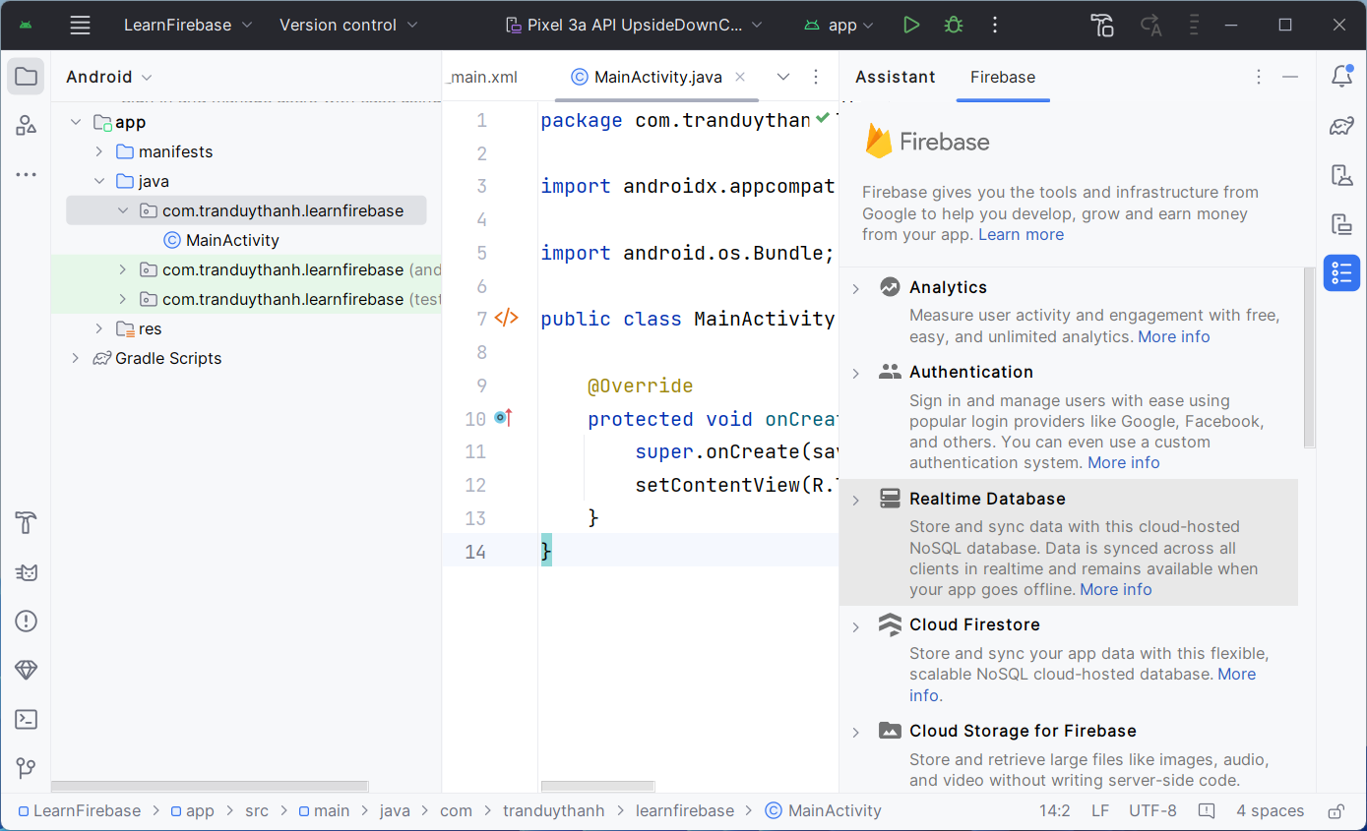
2. Connect App to Firebase
Select “Realtime Database”

Slide 7
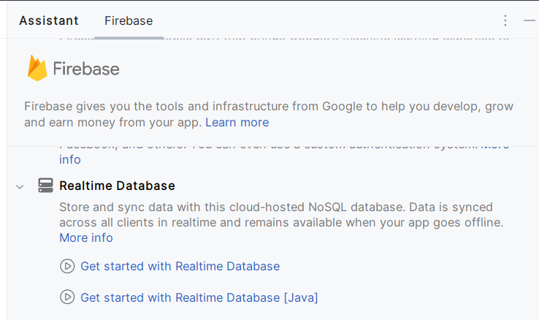
2. Connect App to Firebase

Slide 8
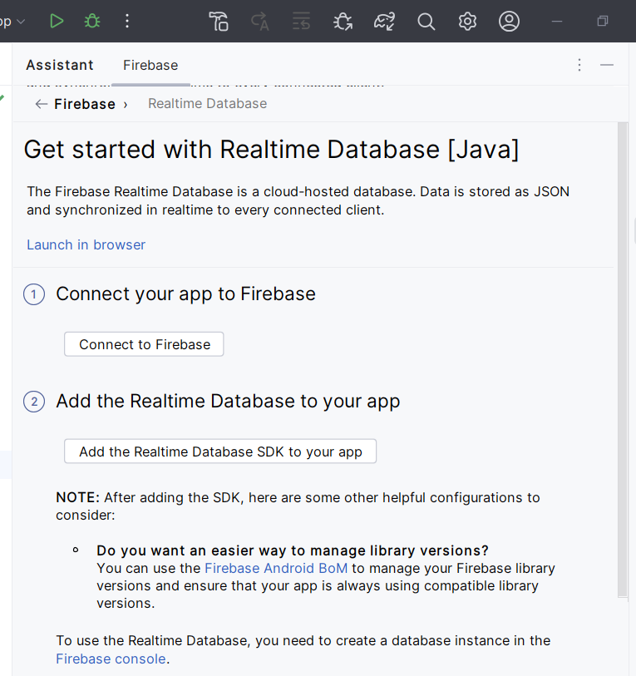
2. Connect App to Firebase

Slide 9
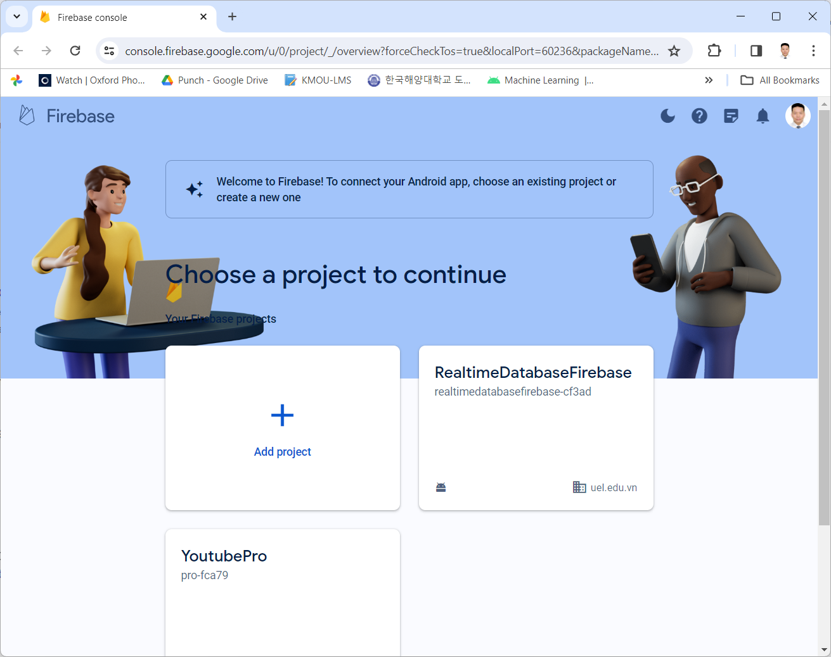
2. Connect App to Firebase

Slide 10
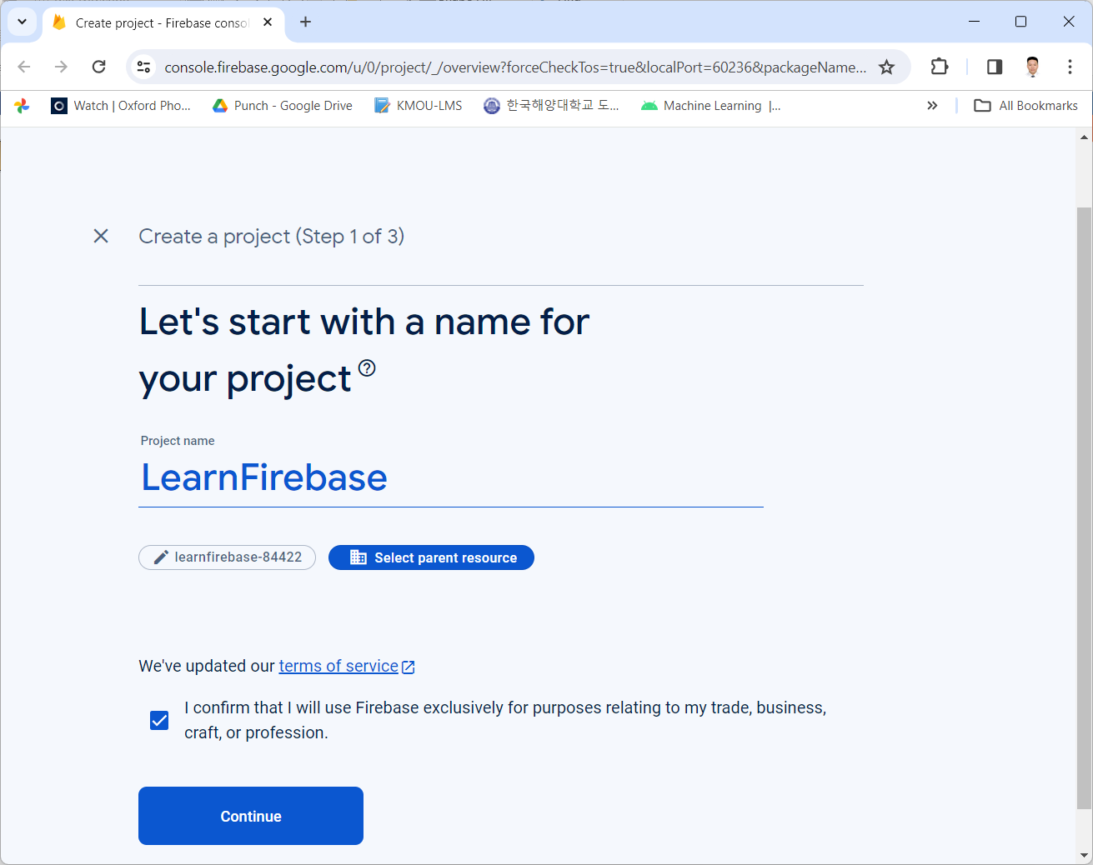
2. Connect App to Firebase

Slide 11
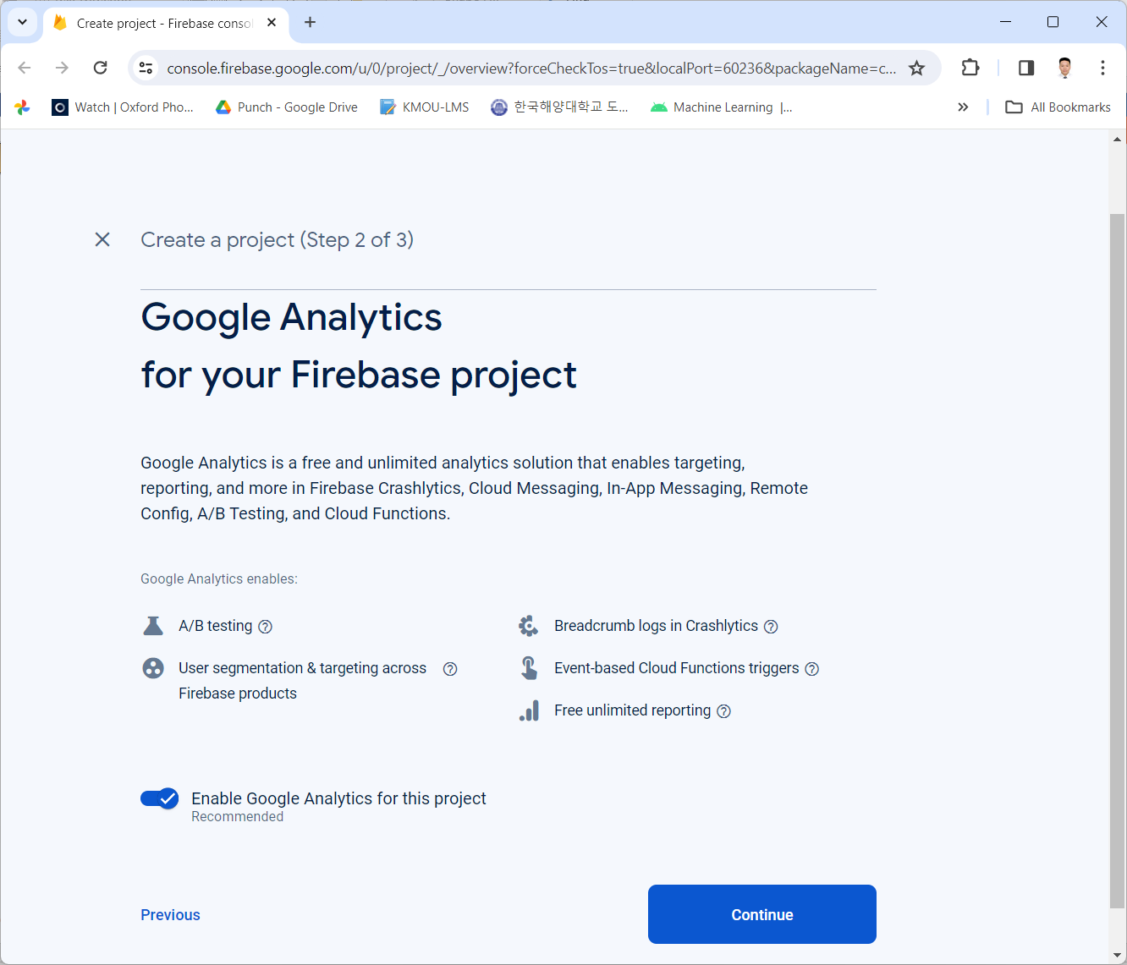
2. Connect App to Firebase

Slide 12
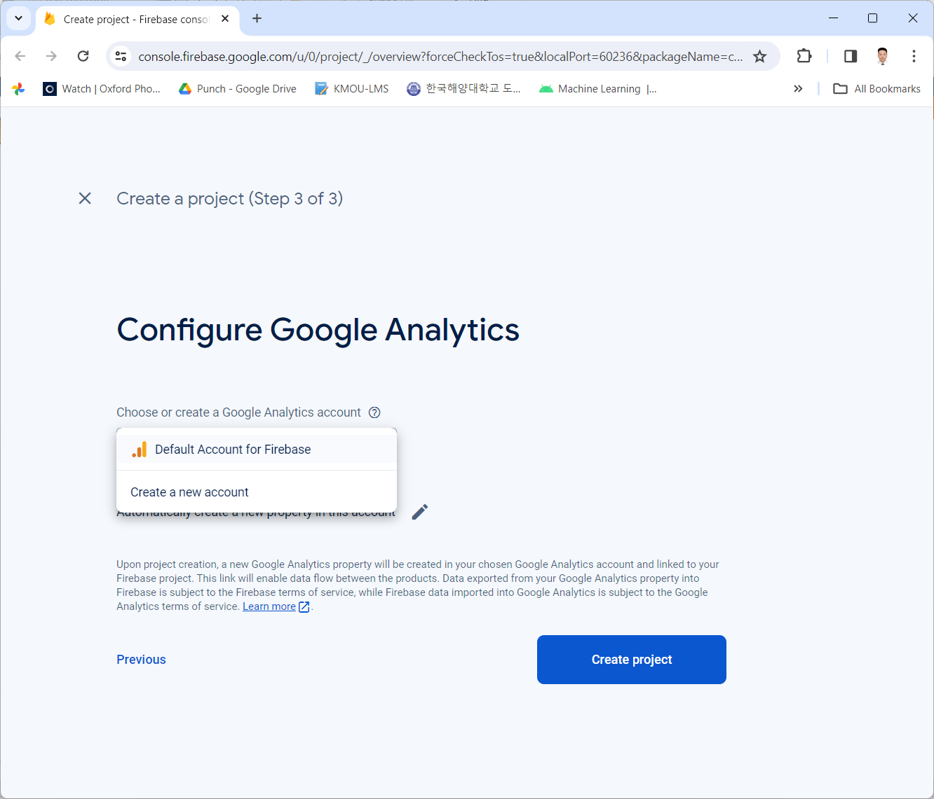
2. Connect App to Firebase

Slide 13
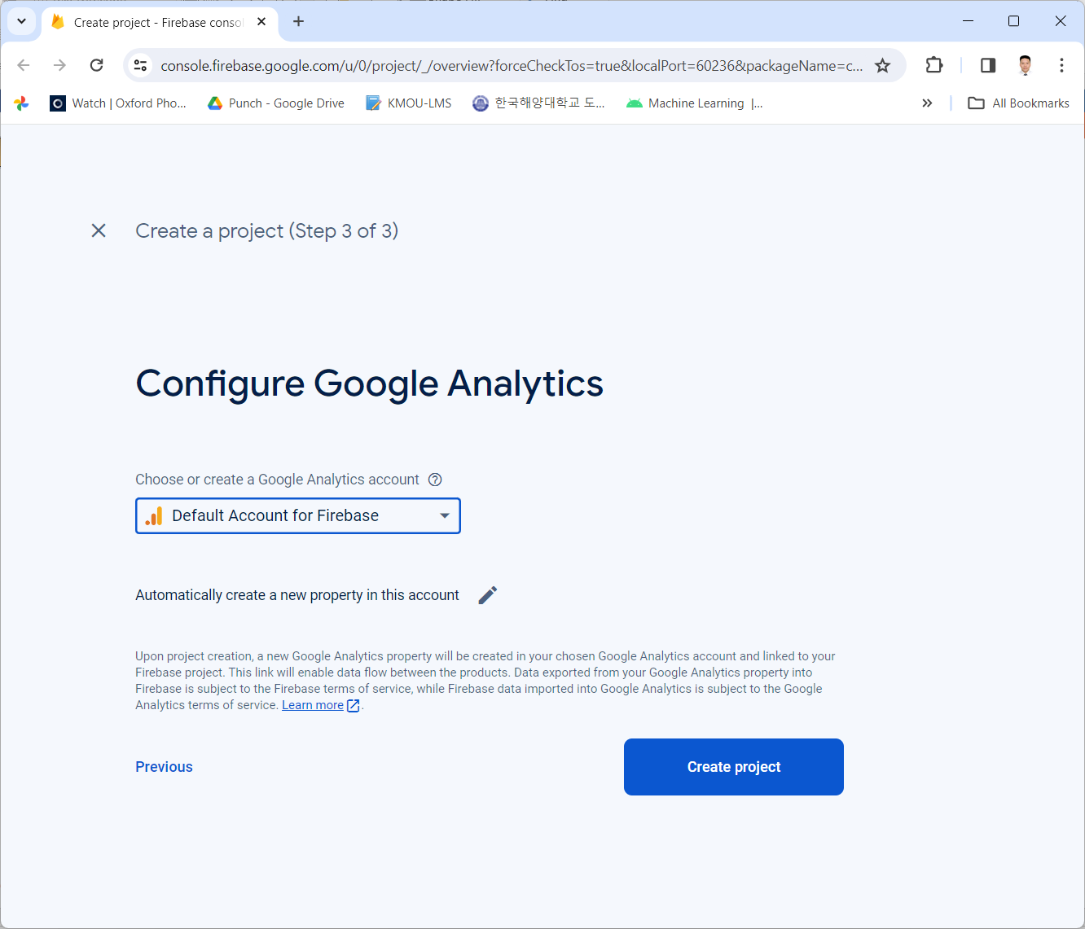
2. Connect App to Firebase

Slide 14
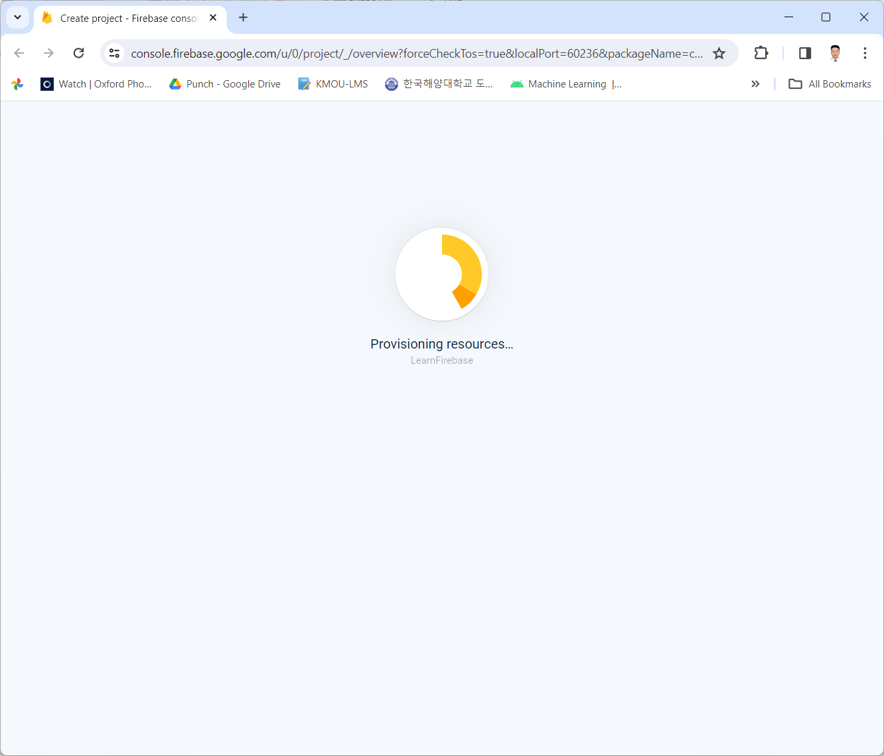
2. Connect App to Firebase

Slide 15
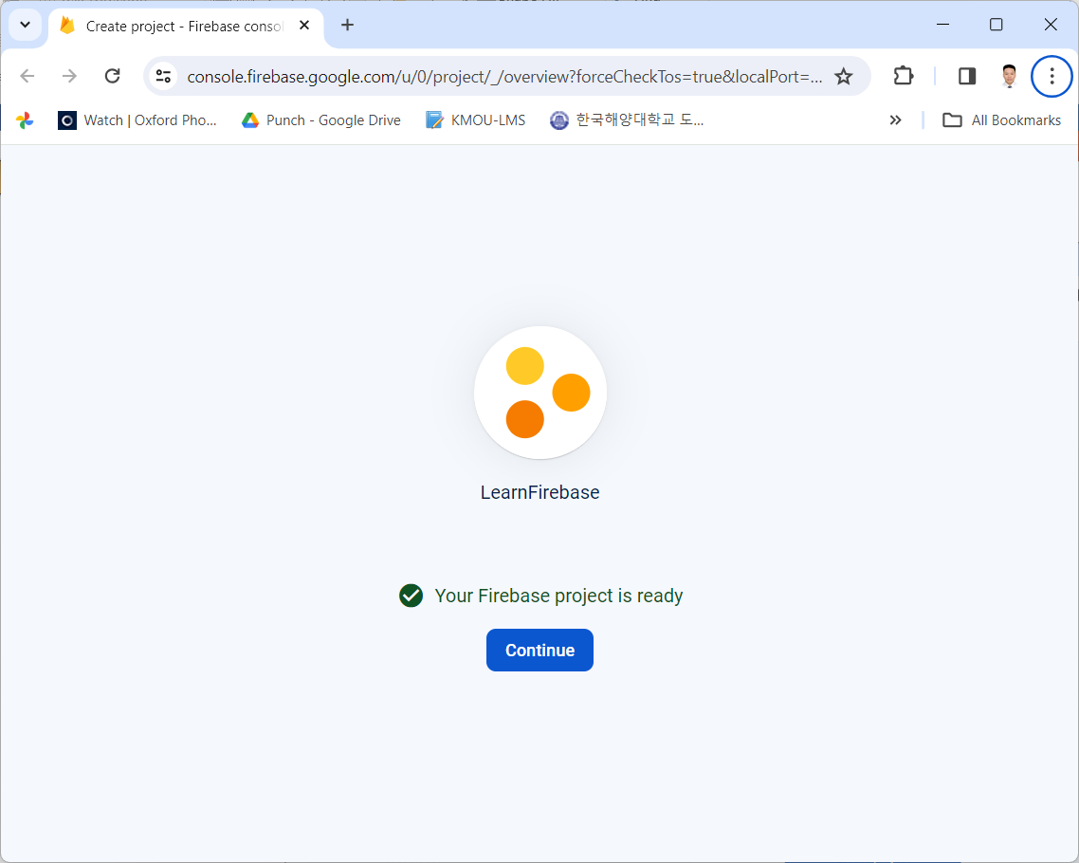
2. Connect App to Firebase

Slide 16
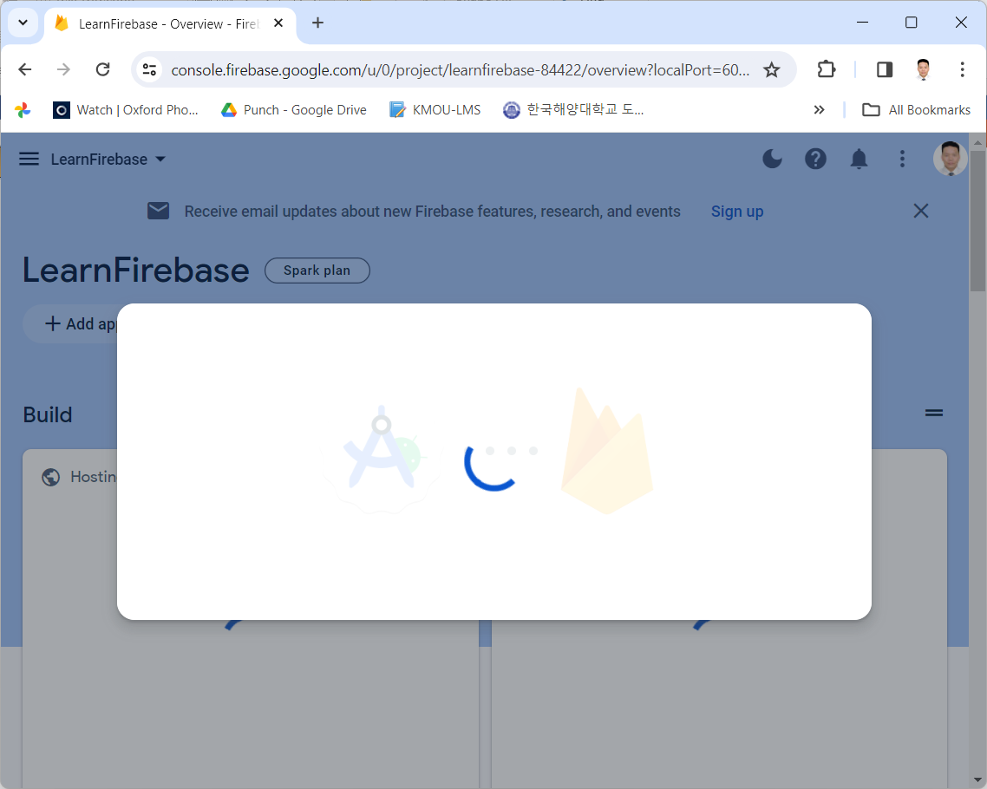
2. Connect App to Firebase

Slide 17
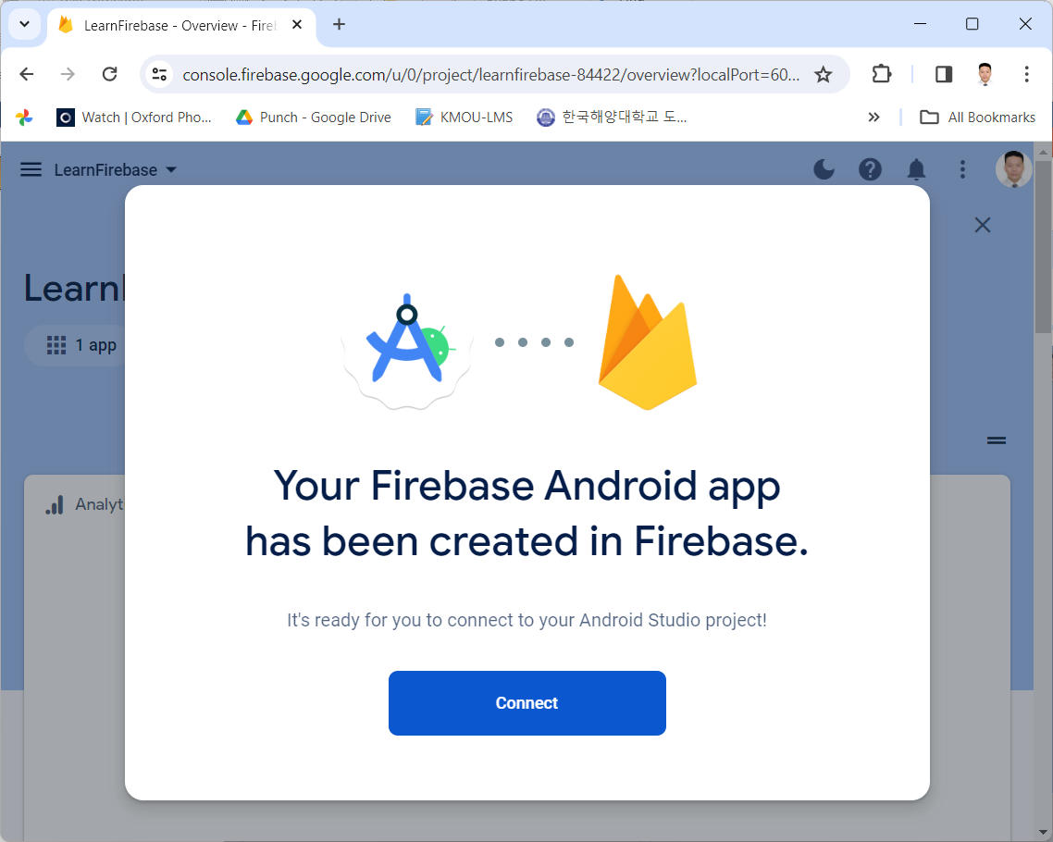
2. Connect App to Firebase

Slide 18
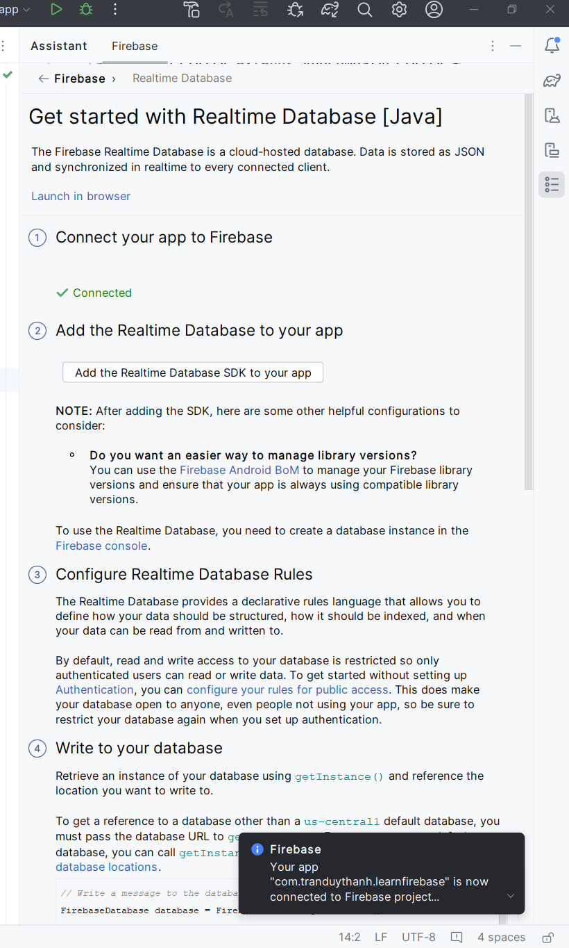
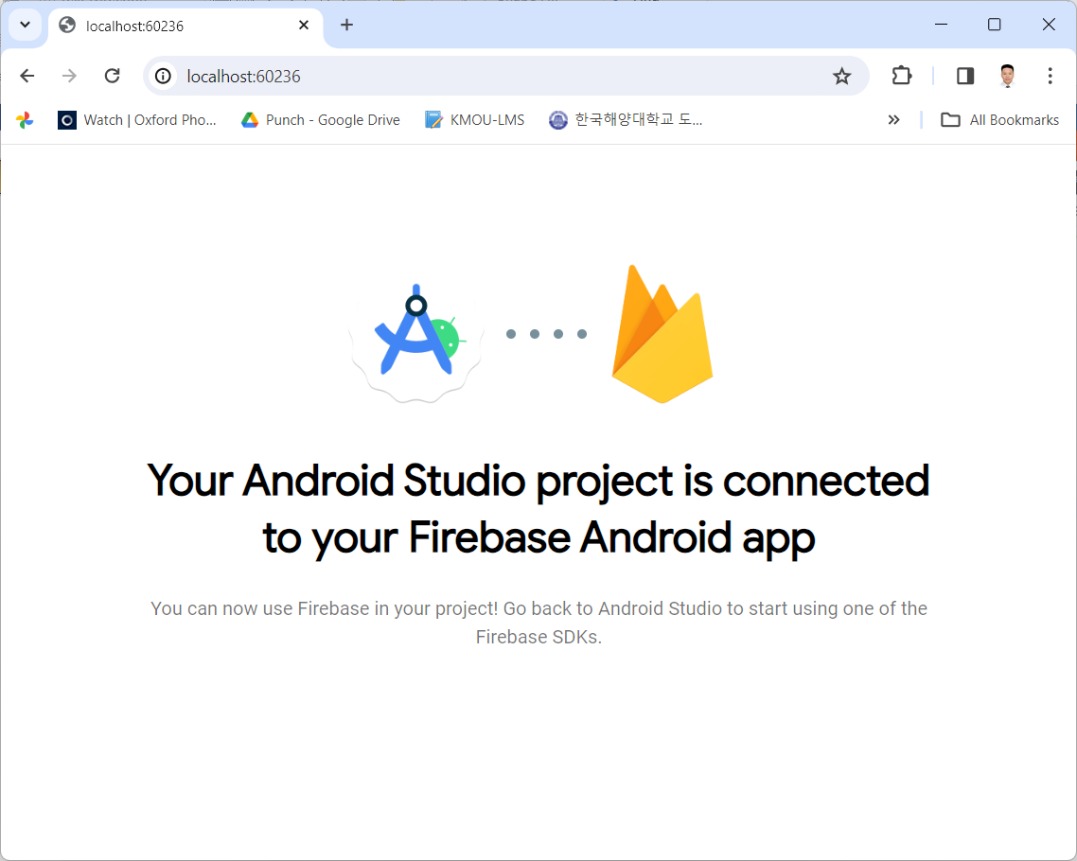
2. Connect App to Firebase

Slide 19
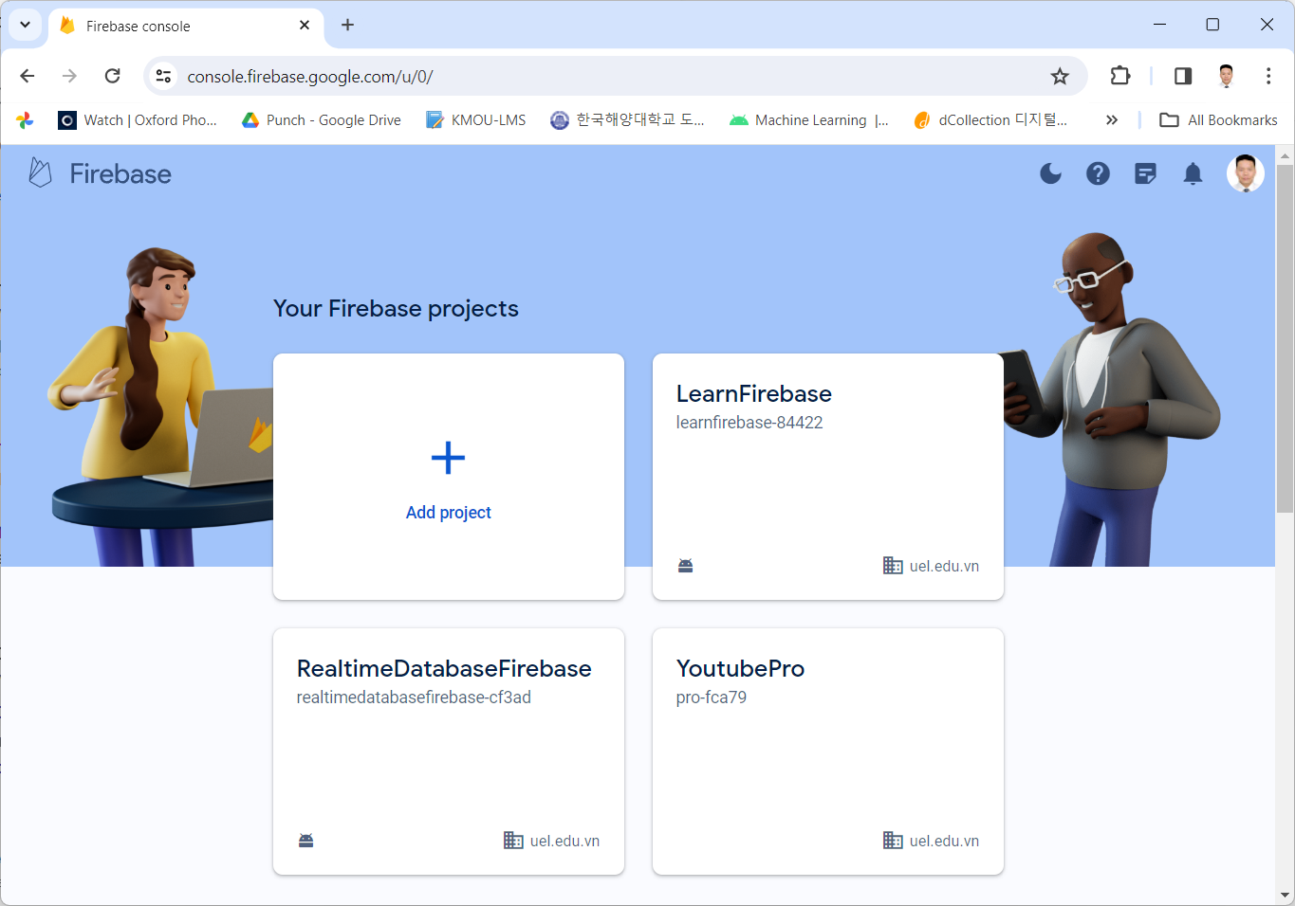
2. Connect App to Firebase

Slide 20
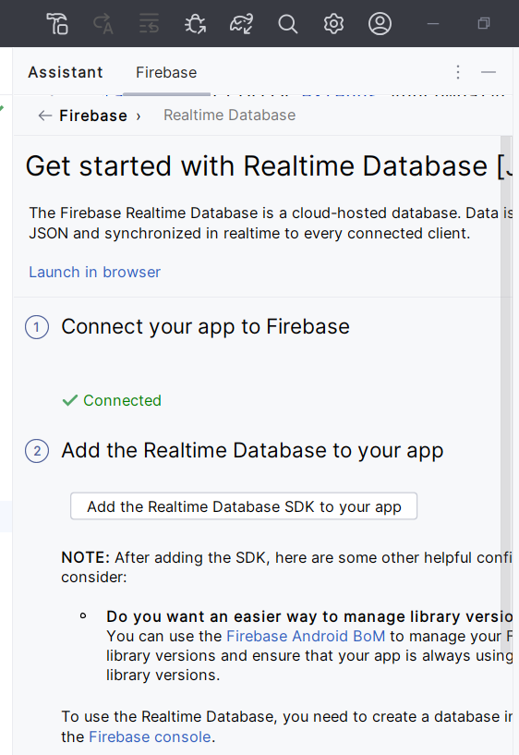
3. Add the Realtime Database to App

Slide 21
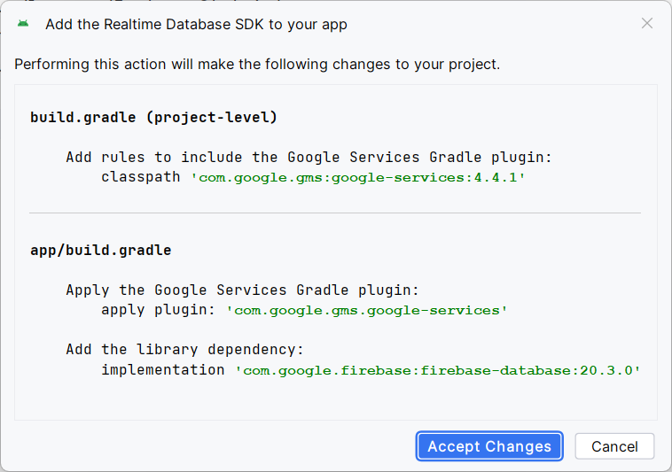
3. Add the Realtime Database to App

Slide 22
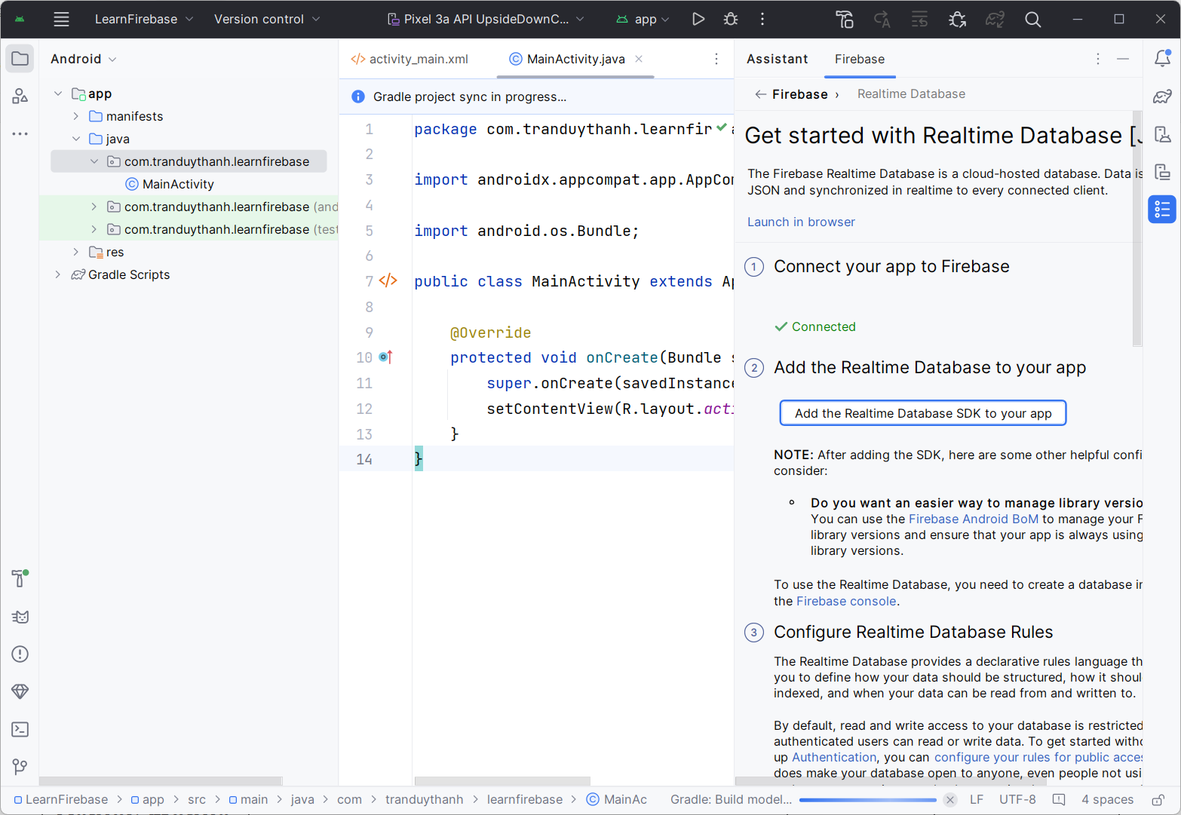
3. Add the Realtime Database to App

Slide 23
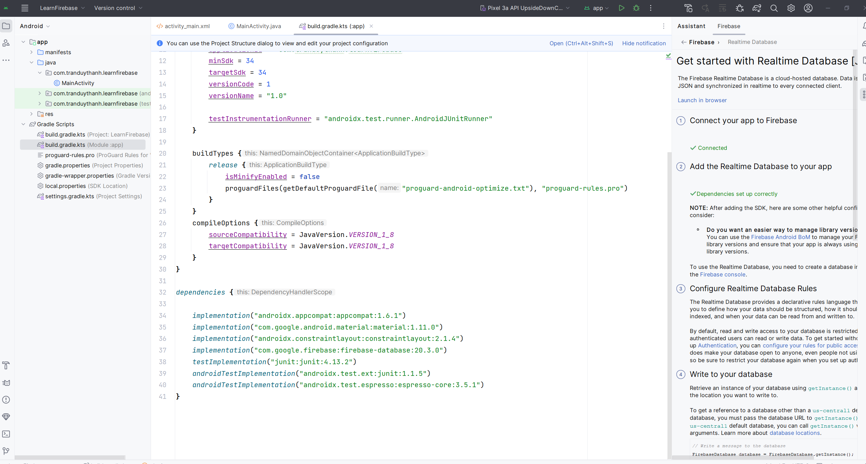
3. Add the Realtime Database to App

Slide 24
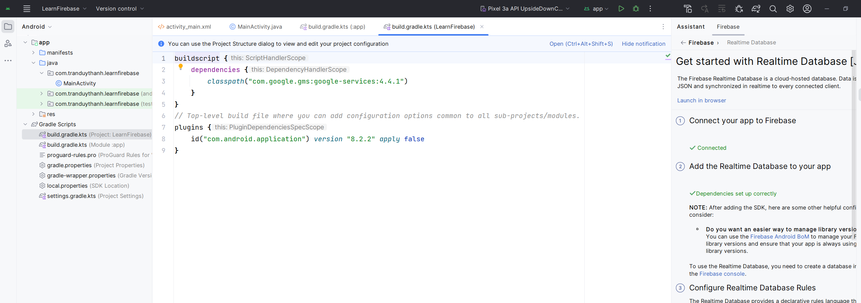
3. Add the Realtime Database to App

Slide 25
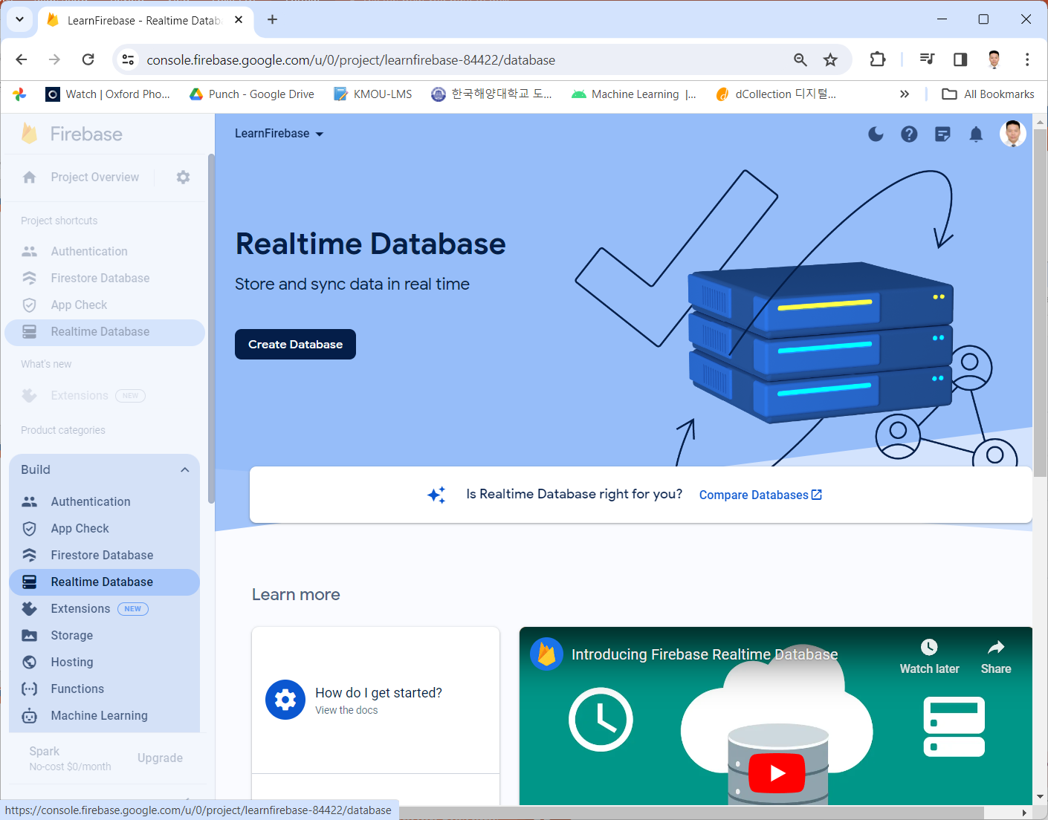
4. Create Realtime Database

Slide 26
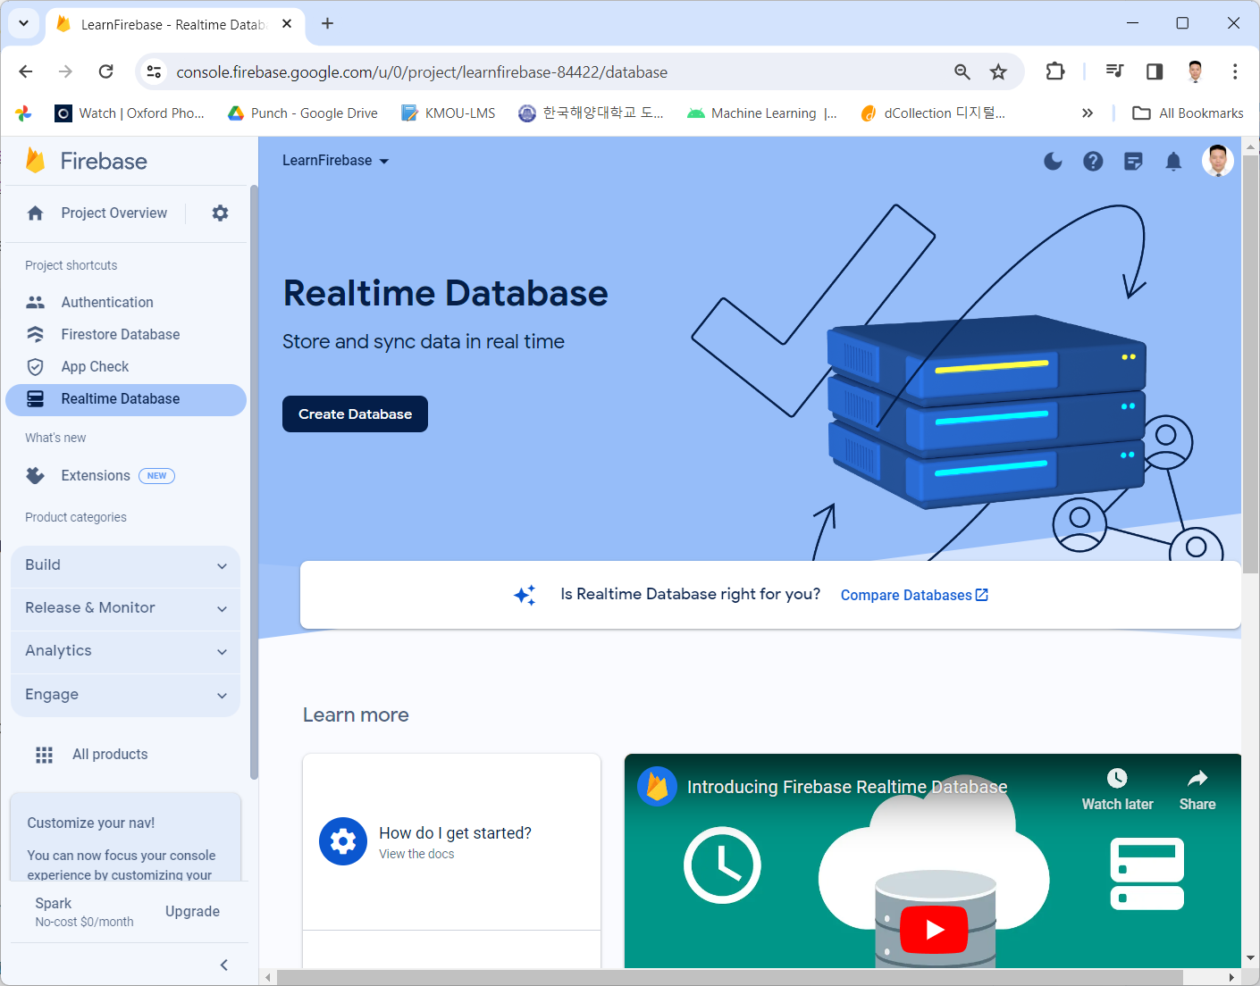
4. Create Realtime Database

Slide 27
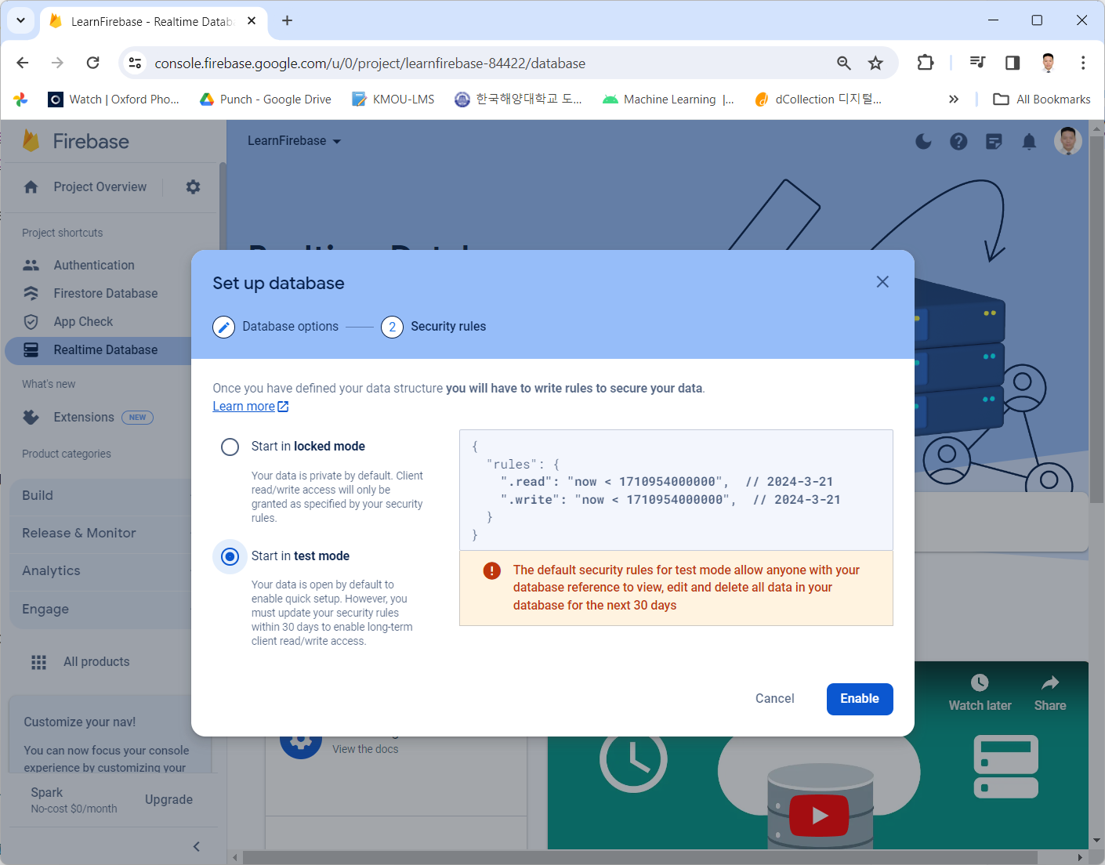
4. Create Realtime Database

Slide 28
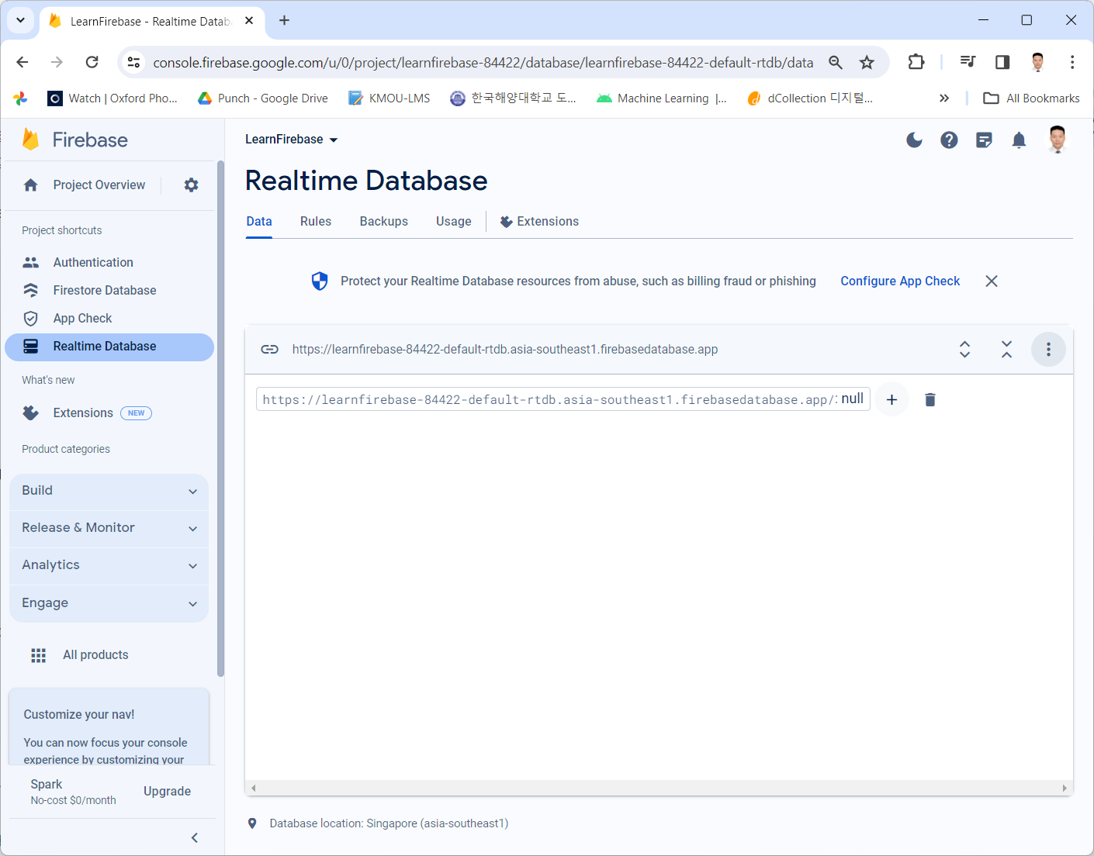
4. Create Realtime Database

Slide 29
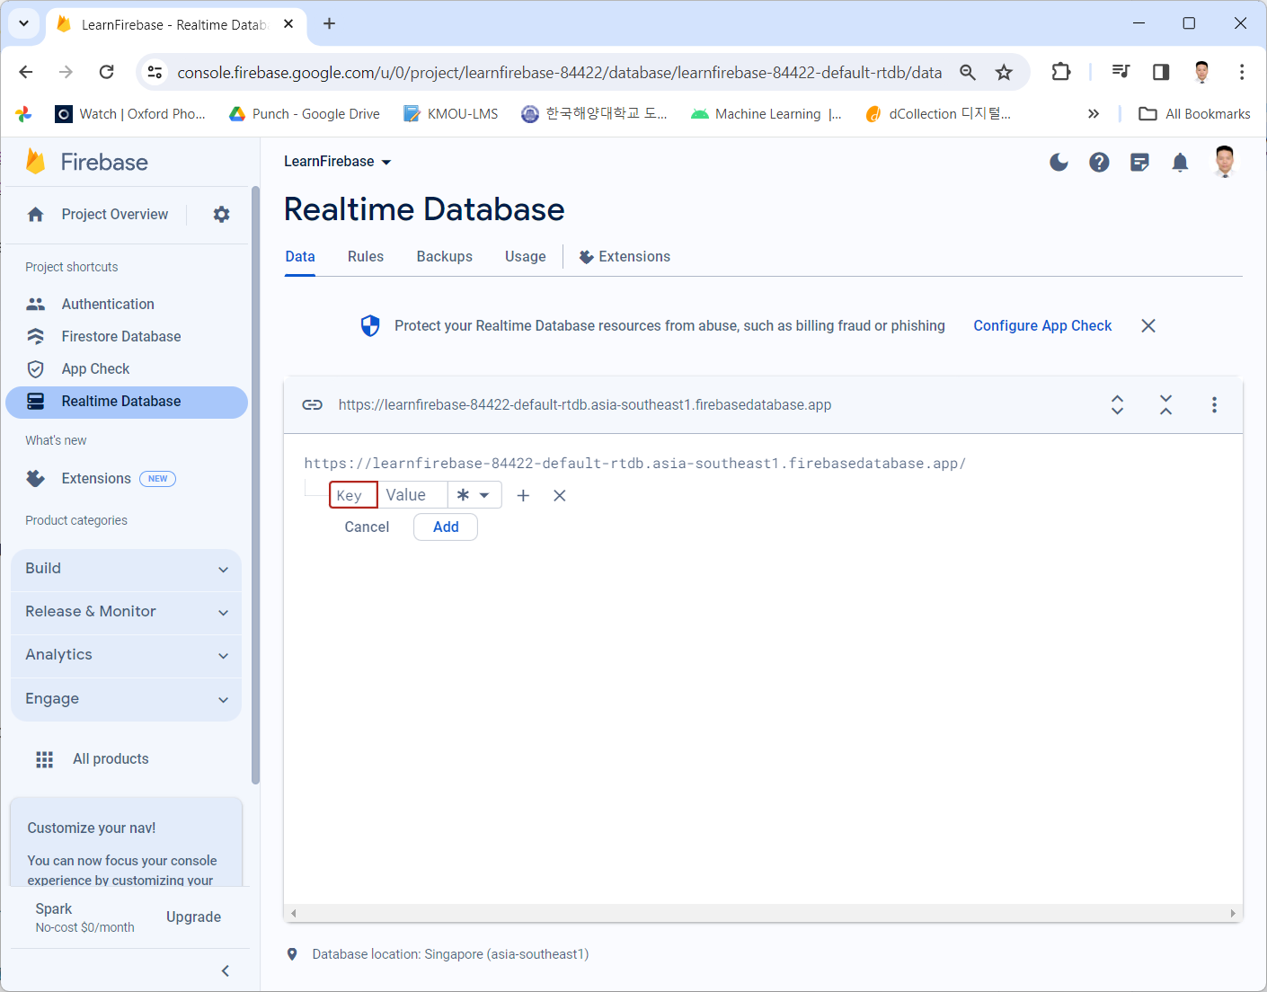
4. Create Realtime Database

Slide 30
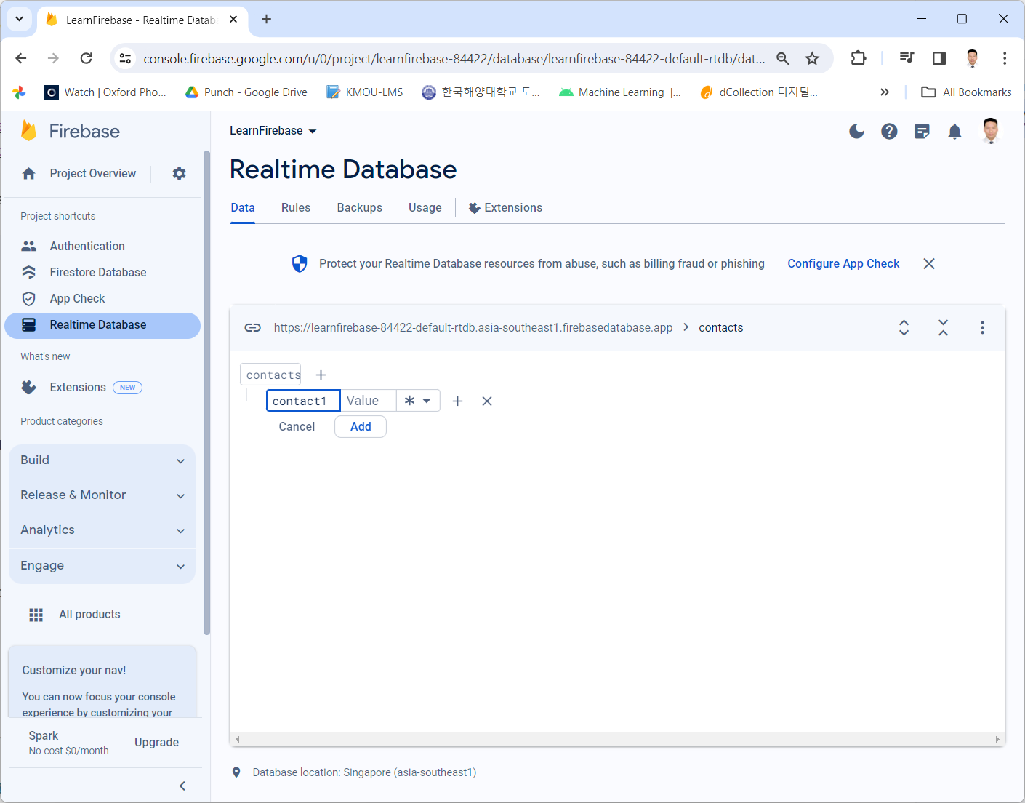
4. Create Realtime Database

Slide 31
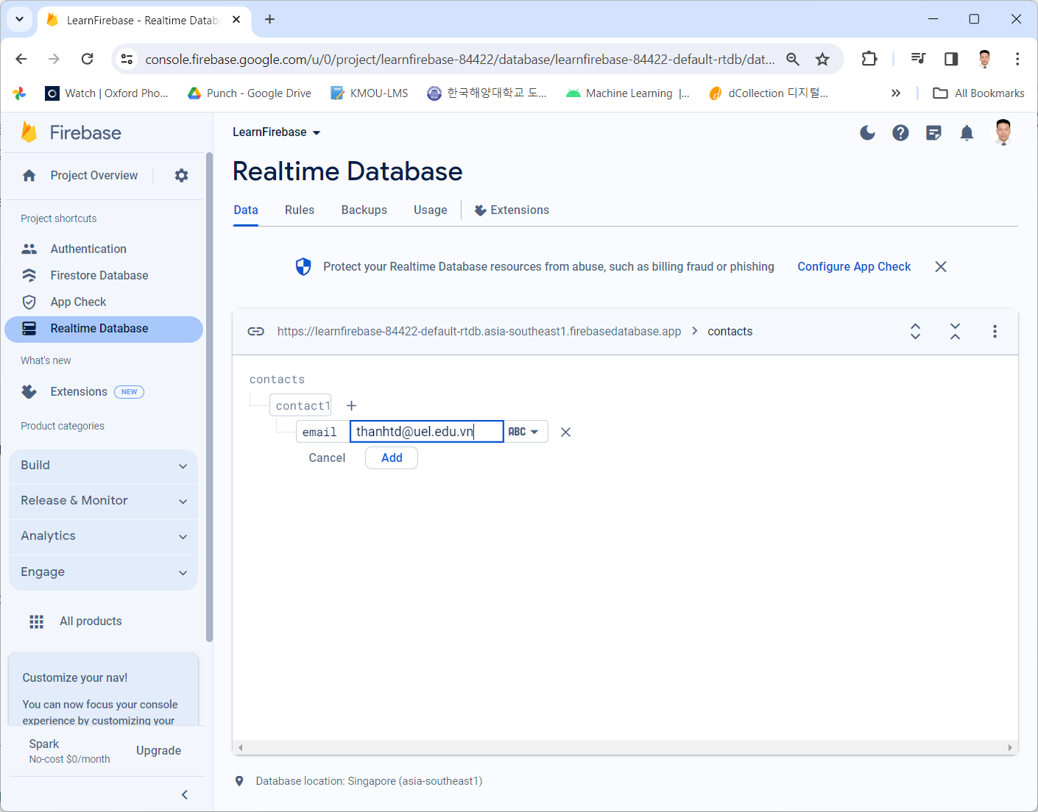
4. Create Realtime Database

Slide 32
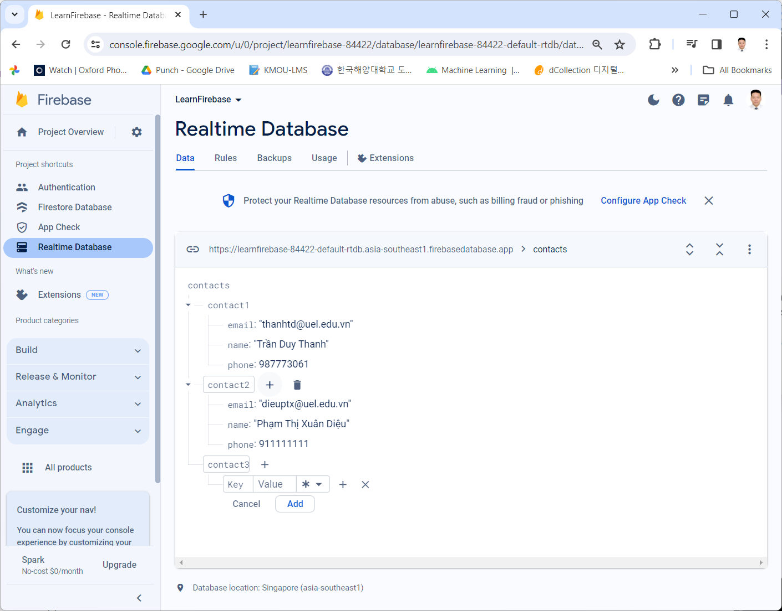
4. Create Realtime Database

Slide 33
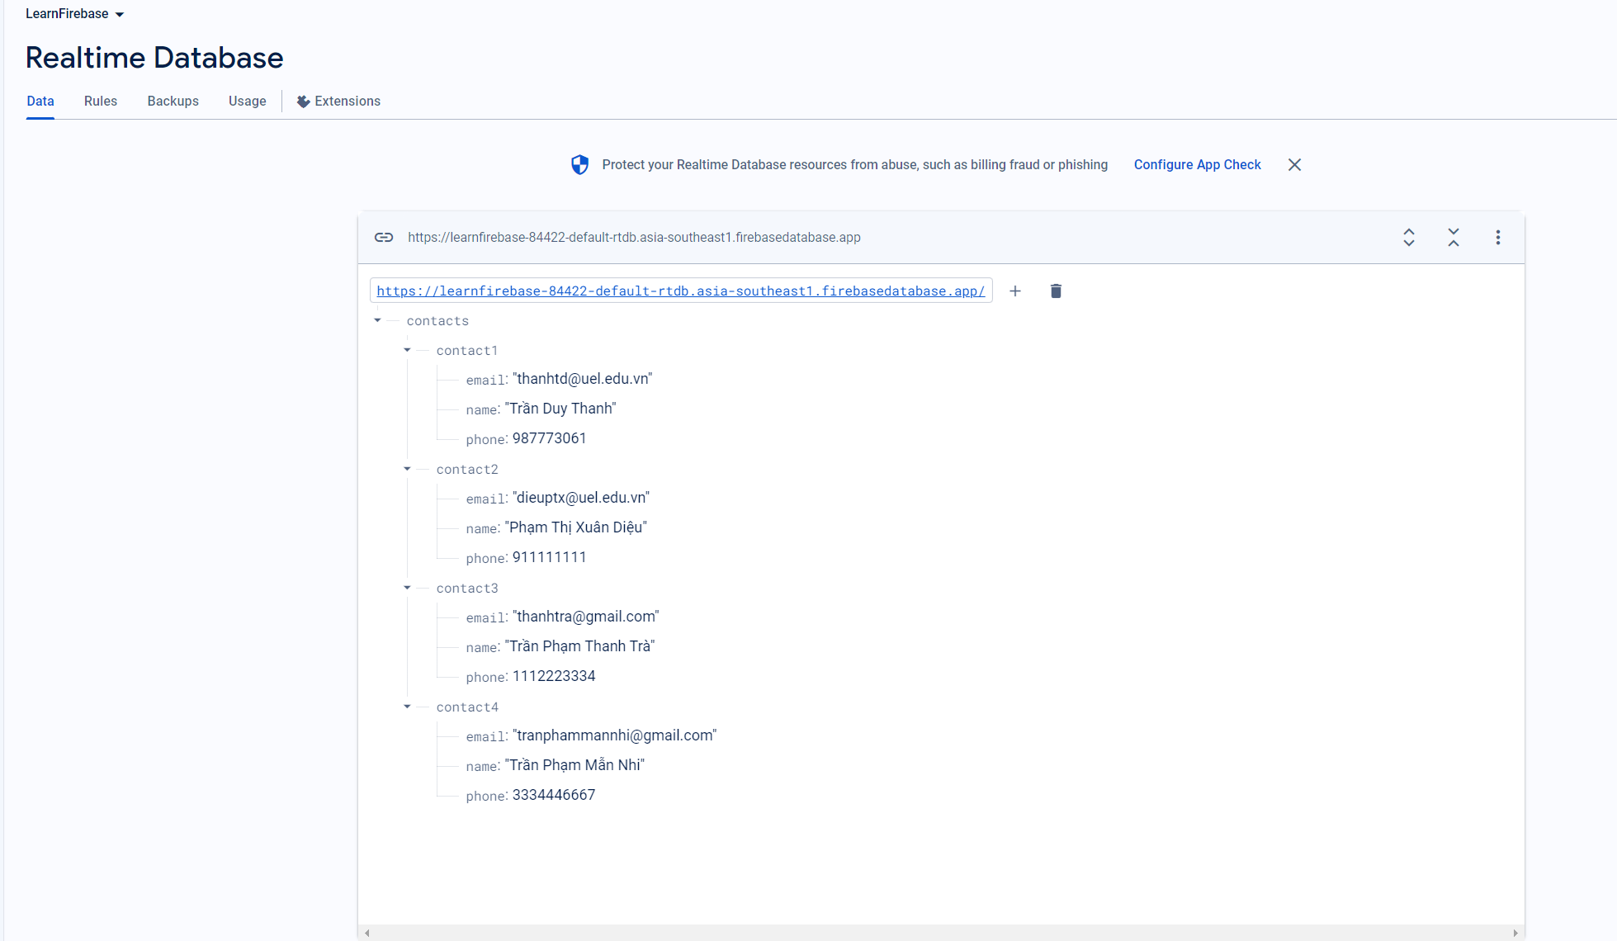
4. Create Realtime Database

Slide 34
5. Read List Firebase Realtime Database
AndroidManifest
<uses-permission android:name="android.permission.INTERNET"/>
<application
… android:usesCleartextTraffic="true"
… >

Slide 35
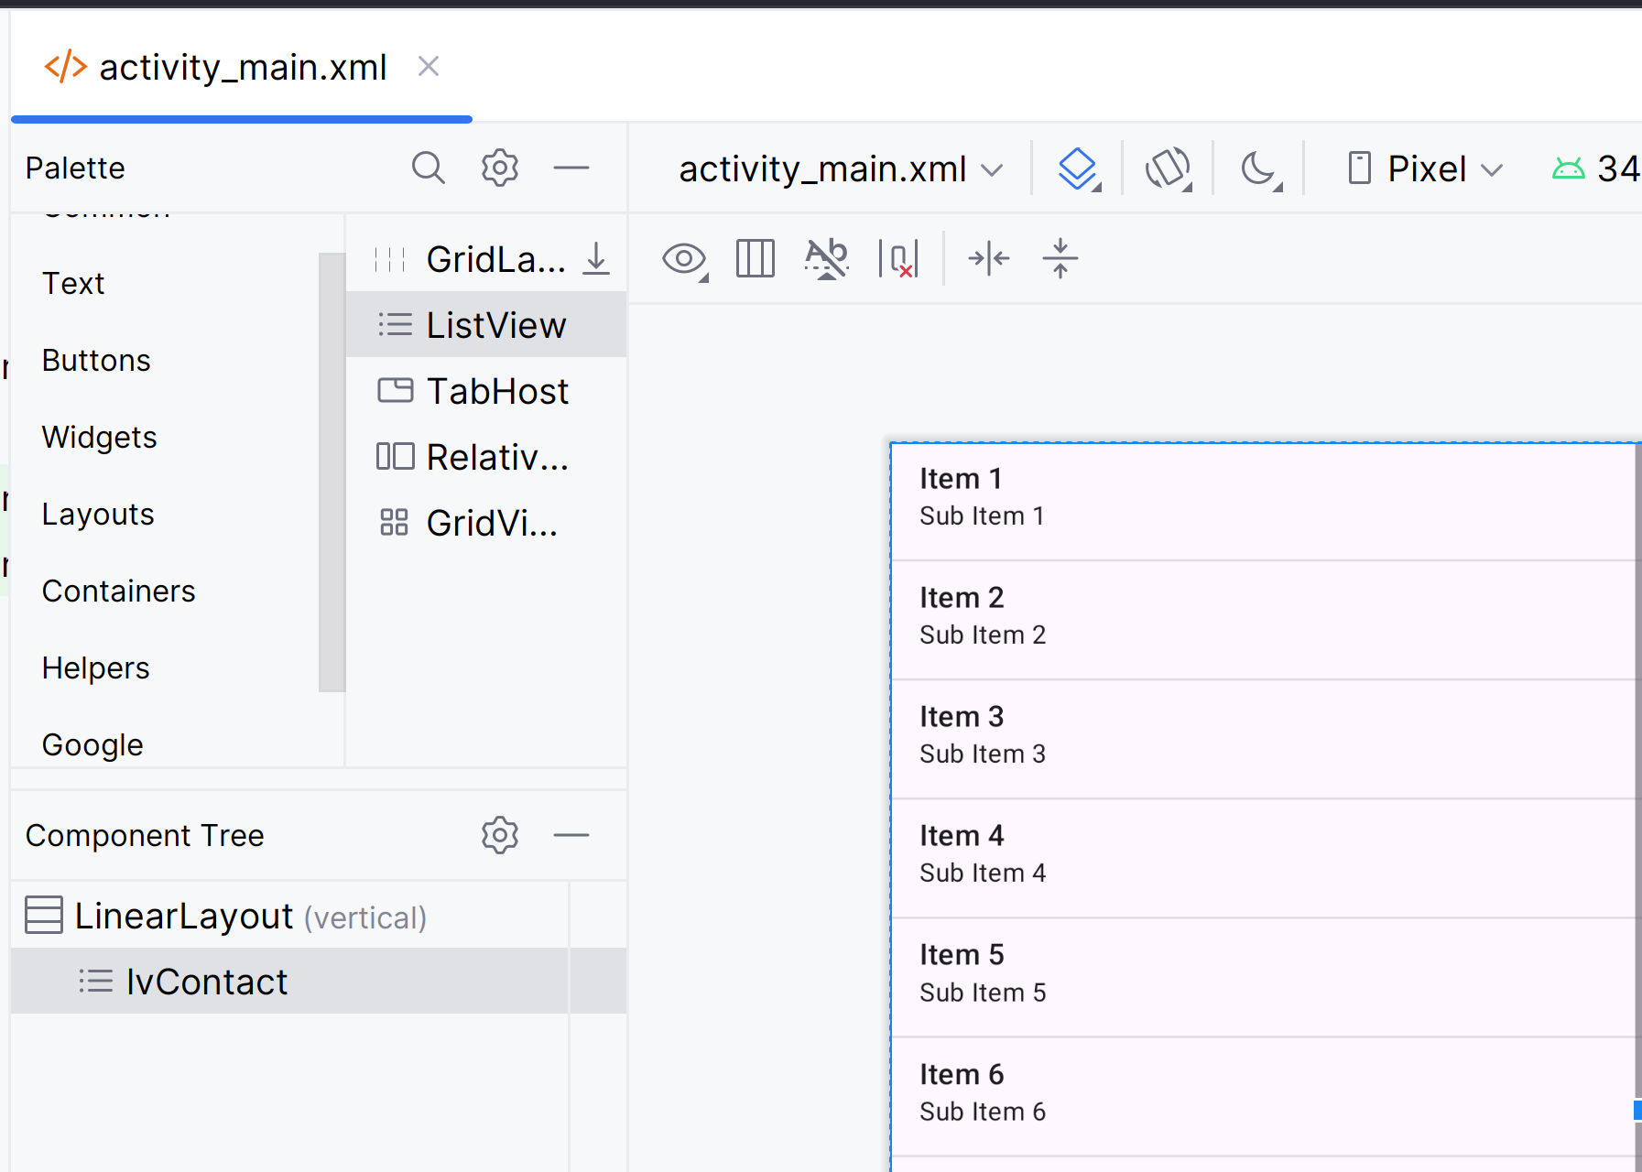
5. Read List Firebase Realtime Database
MainActivity
<?xml version="1.0" encoding="utf-8"?> <LinearLayout xmlns:android="http://schemas.android.com/apk/res/android" xmlns:app="http://schemas.android.com/apk/res-auto" xmlns:tools="http://schemas.android.com/tools" android:layout_width="match_parent" android:layout_height="match_parent" android:orientation="vertical" tools:context=".MainActivity"> <ListView android:id="@+id/lvContact" android:layout_width="match_parent" android:layout_height="match_parent" /> </LinearLayout>

Slide 36
5. Read List Firebase Realtime Database
public class MainActivity extends AppCompatActivity { ListView lvContact; ArrayAdapter<String>contactAdapter; String TAG="FIREBASE"; @Override protected void onCreate(Bundle savedInstanceState) { super.onCreate(savedInstanceState); setContentView(R.layout.activity_main); addViews(); } private void addViews() { lvContact=findViewById(R.id.lvContact); contactAdapter=new ArrayAdapter<>(MainActivity.this, android.R.layout.simple_list_item_1); lvContact.setAdapter(contactAdapter); loadData(); }

Slide 37
5. Read List Firebase Realtime Database
private void loadData() { FirebaseDatabase database = FirebaseDatabase.getInstance(); DatabaseReference myRef = database.getReference("contacts"); myRef.addValueEventListener(new ValueEventListener() { @Override public void onDataChange(DataSnapshot dataSnapshot) { contactAdapter.clear(); for (DataSnapshot data: dataSnapshot.getChildren()) { String key=data.getKey(); String value=data.getValue().toString(); contactAdapter.add(key+"\n"+value); } } @Override public void onCancelled(DatabaseError databaseError) { Log.w(TAG, "loadPost:onCancelled", databaseError.toException()); } }); } }

Slide 38
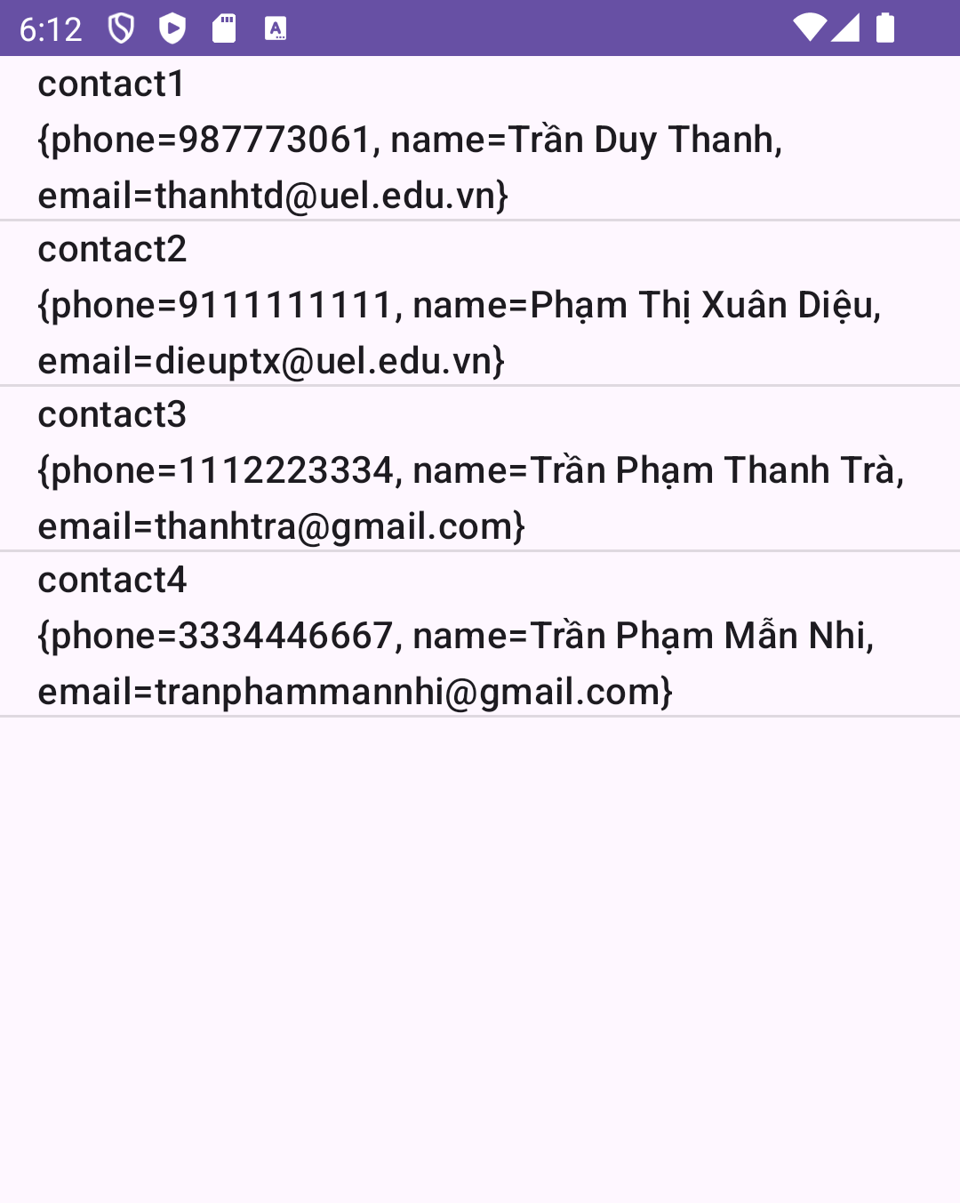
5. Read List Firebase Realtime Database
Automatic updating UI

Slide 39
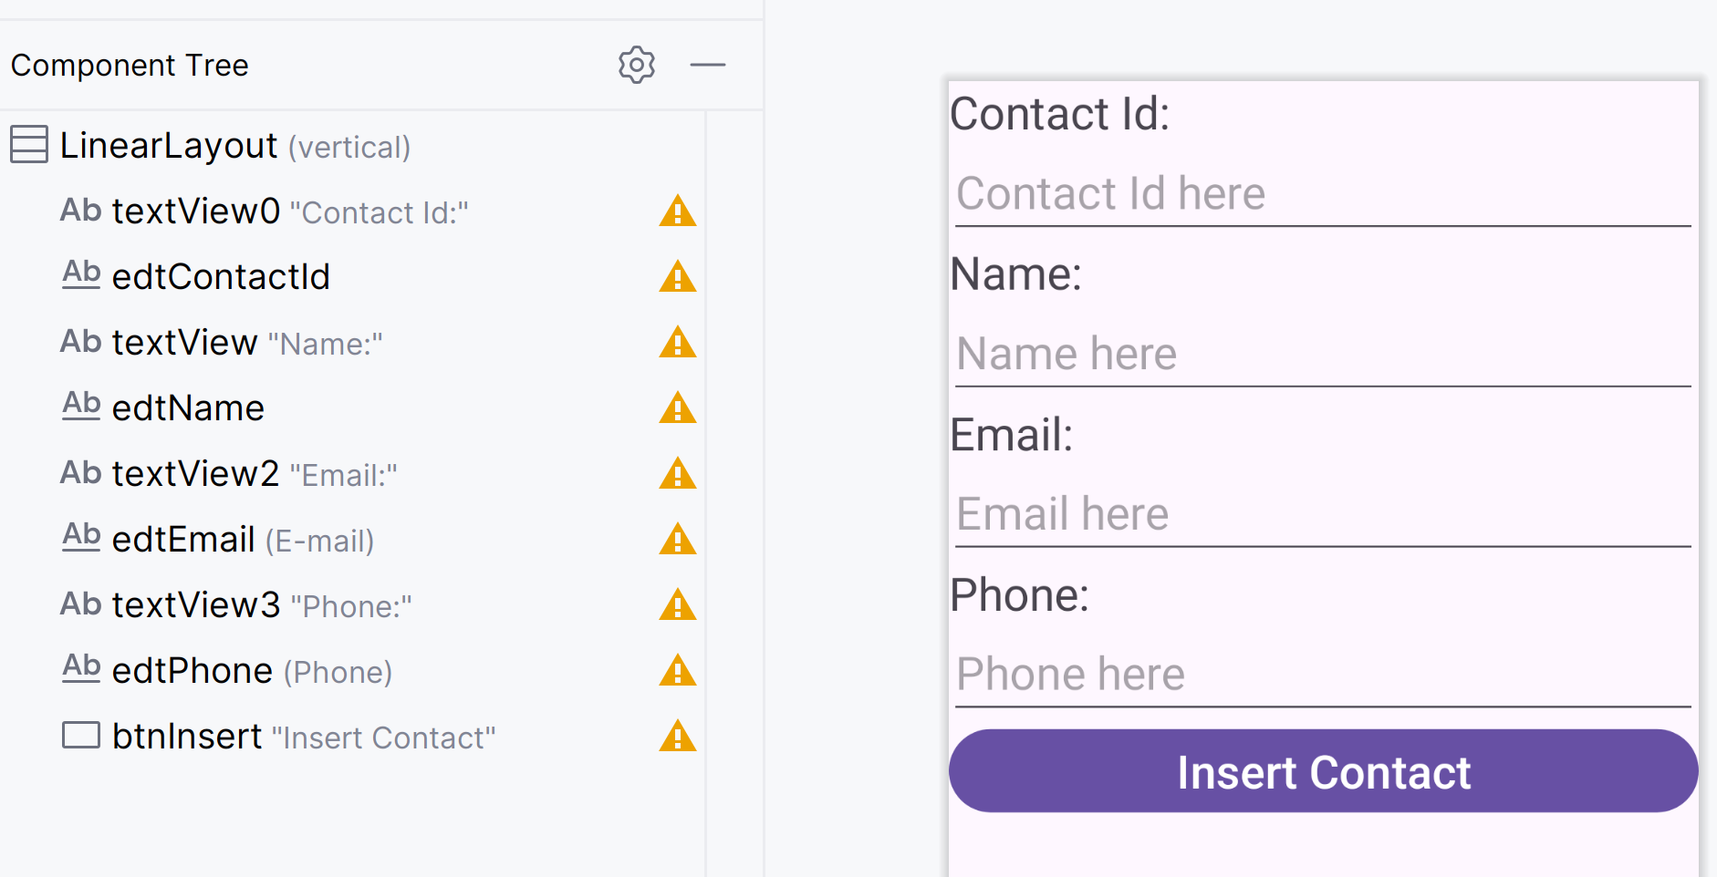
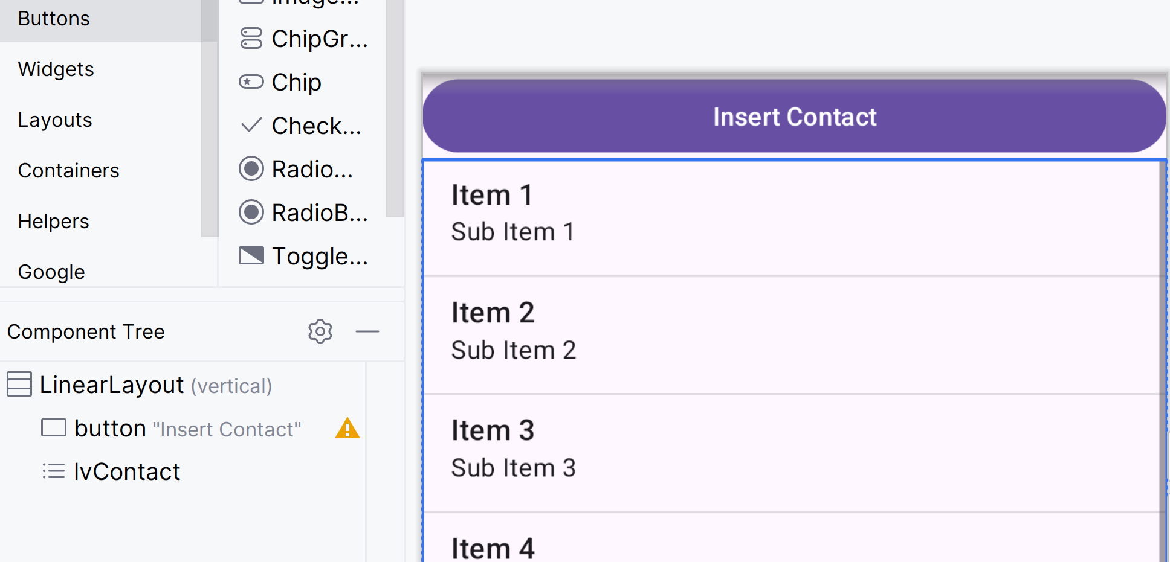
6. Insert Firebase Realtime Database
MainActivity
InsertContactActivity

Slide 40
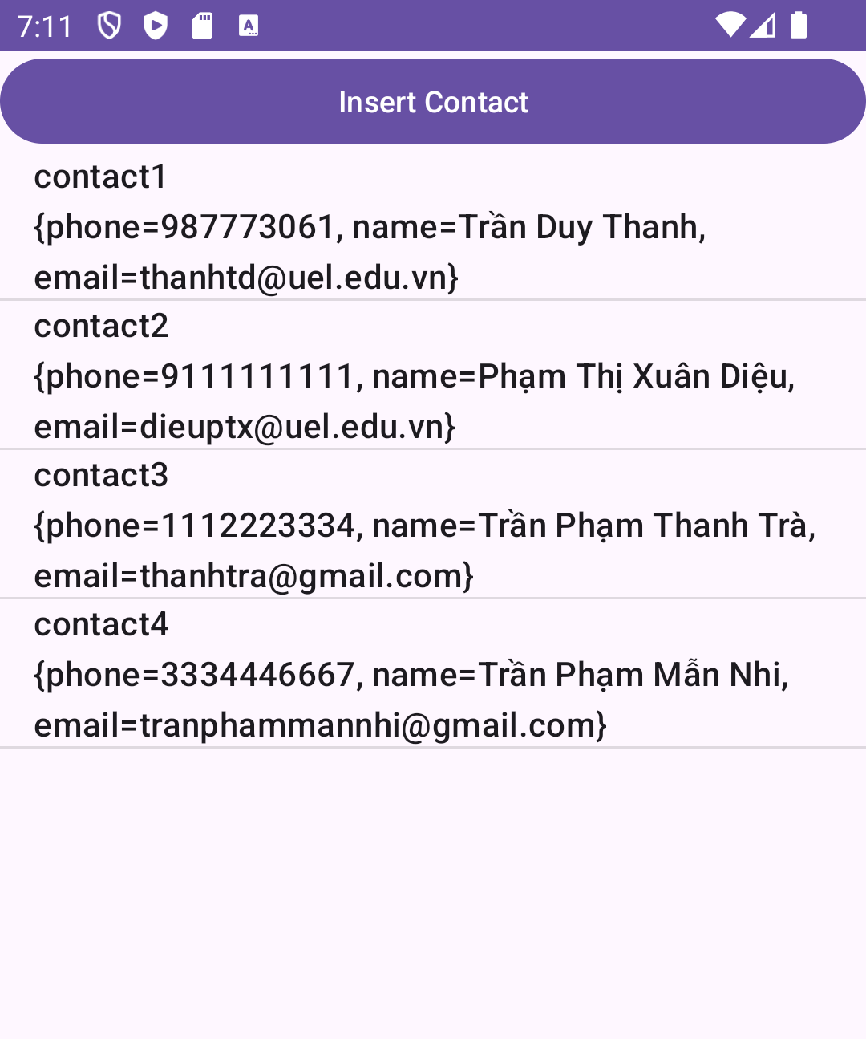
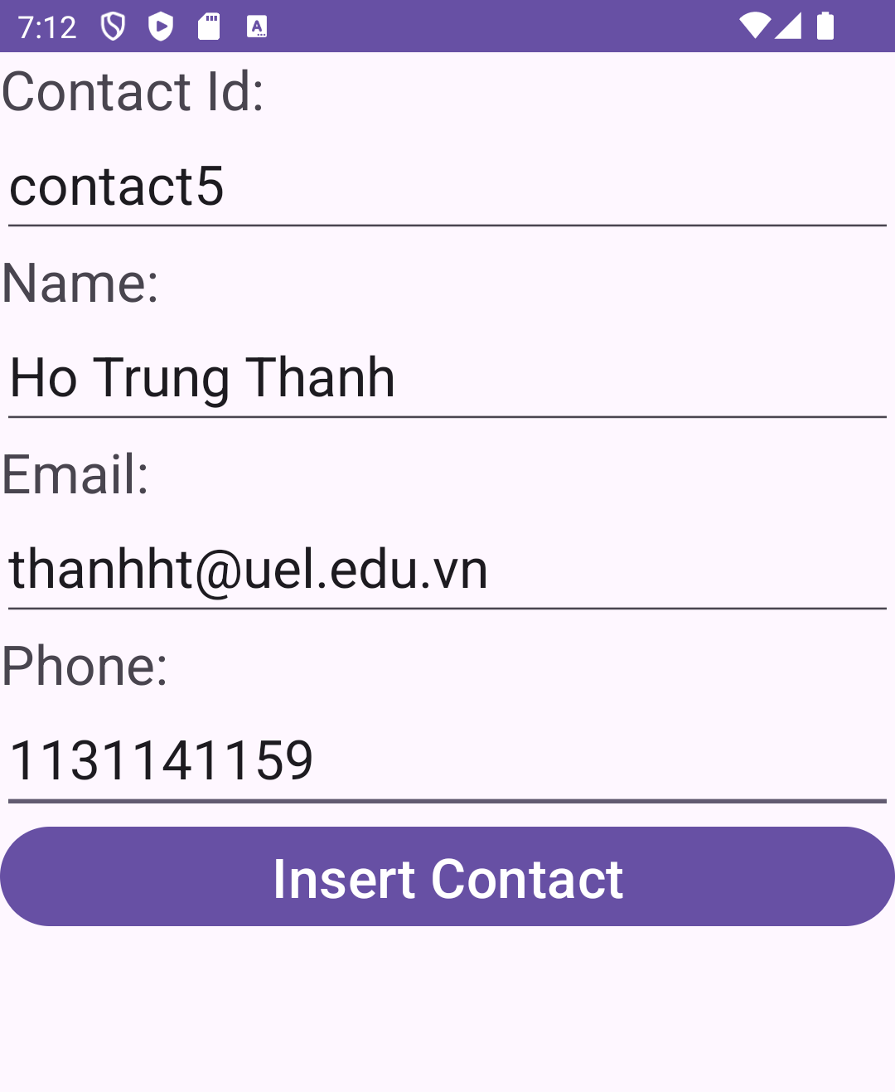
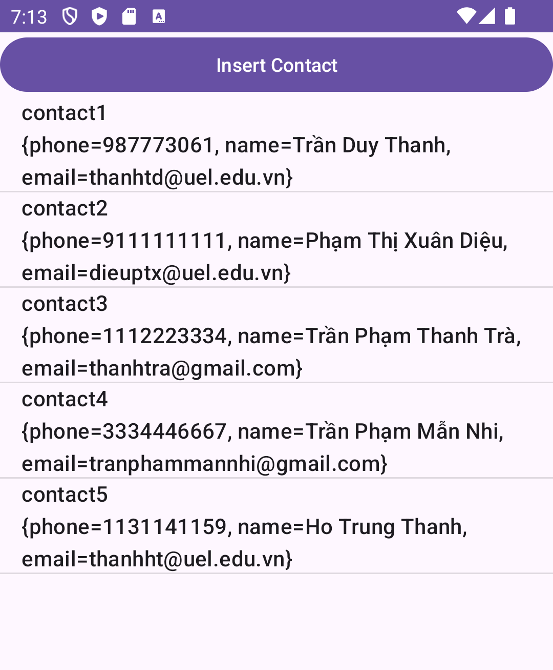
6. Insert Firebase Realtime Database
InsertContactActivity

Slide 41
6. Insert Firebase Realtime Database
public class InsertContactActivity extends AppCompatActivity { EditText edtId,edtName,edtPhone,edtEmail; @Override protected void onCreate(Bundle savedInstanceState) { super.onCreate(savedInstanceState); setContentView(R.layout.activity_insert_contact); addViews(); } private void addViews() { edtId=findViewById(R.id.edtContactId); edtName=findViewById(R.id.edtName); edtPhone=findViewById(R.id.edtPhone); edtEmail=findViewById(R.id.edtEmail); }

Slide 42
6. Insert Firebase Realtime Database
public void processInsertContact(View view) { try { FirebaseDatabase database = FirebaseDatabase.getInstance(); DatabaseReference myRef = database.getReference("contacts"); String contactId=edtId.getText().toString(); String name = edtName.getText().toString(); String phone = edtPhone.getText().toString(); String email = edtEmail.getText().toString(); myRef.child(contactId).child("phone").setValue(phone); myRef.child(contactId).child("email").setValue(email); myRef.child(contactId).child("name").setValue(name); finish(); } catch (Exception ex) { Toast.makeText(this,"Error:"+ex.toString(),Toast.LENGTH_LONG).show(); } } }

Slide 43
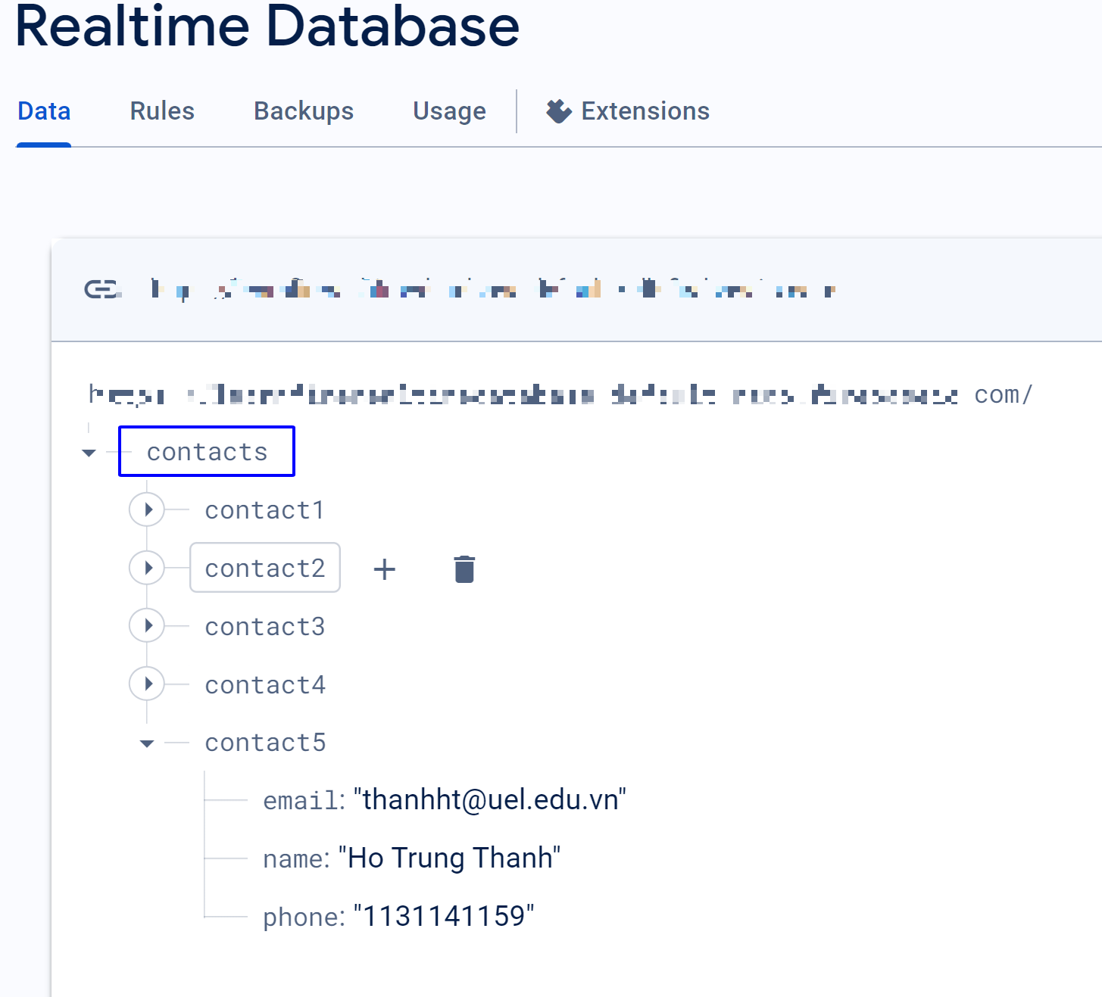
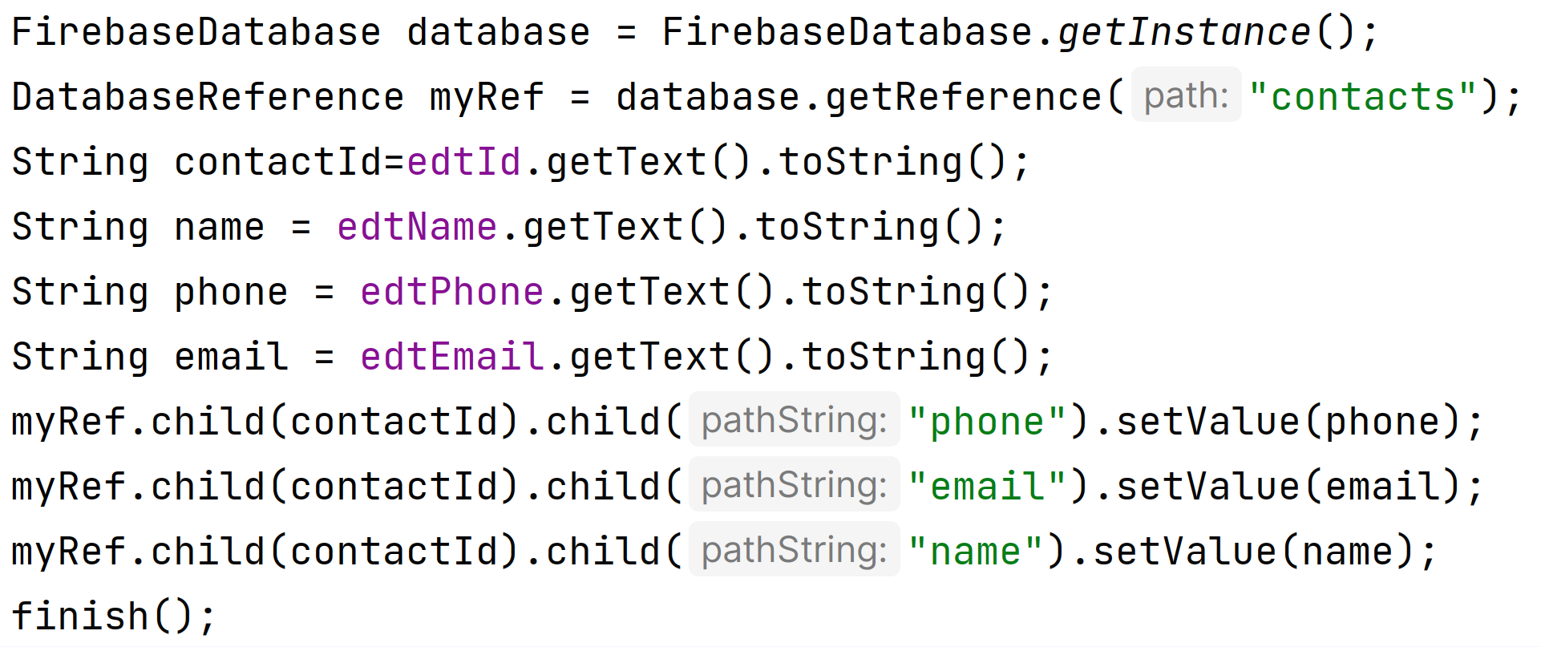
6. Insert Firebase Realtime Database

Slide 44

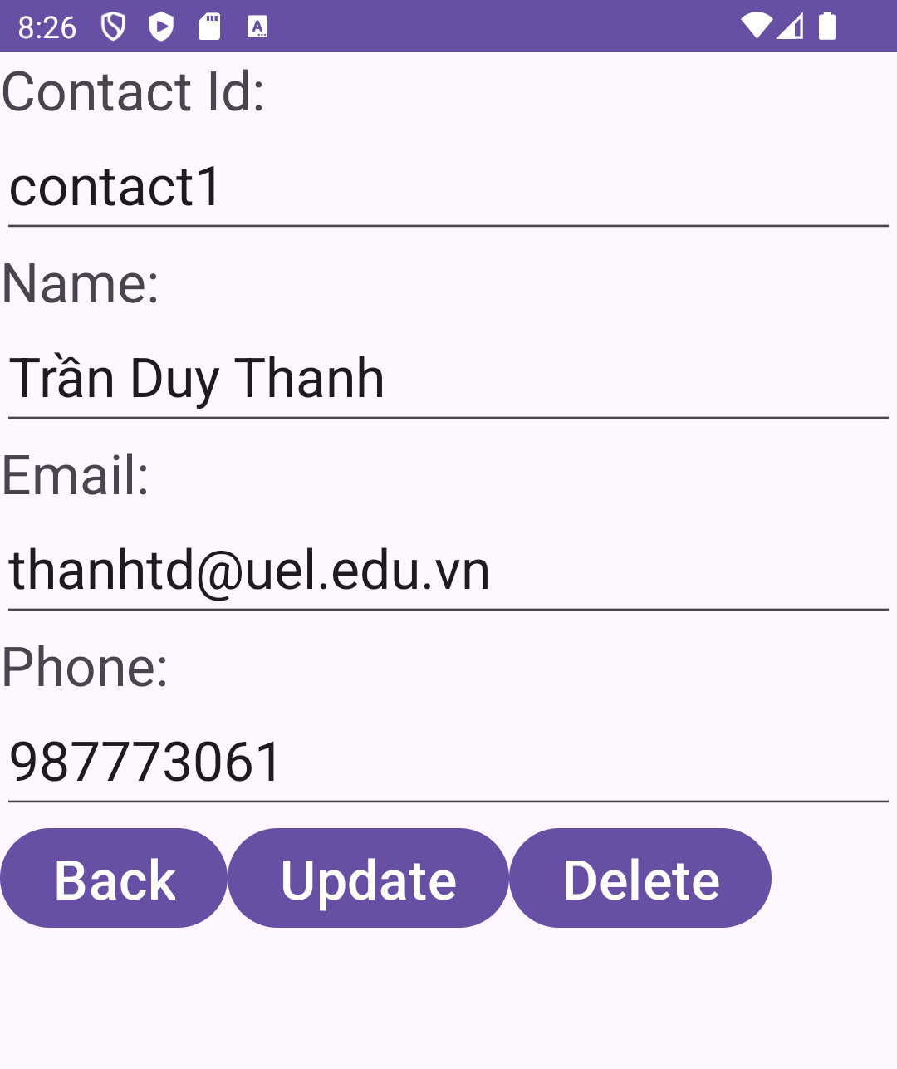
7. Read Single Data Firebase Realtime Database
touch
MainActivity
DetailContactActivity

Slide 45
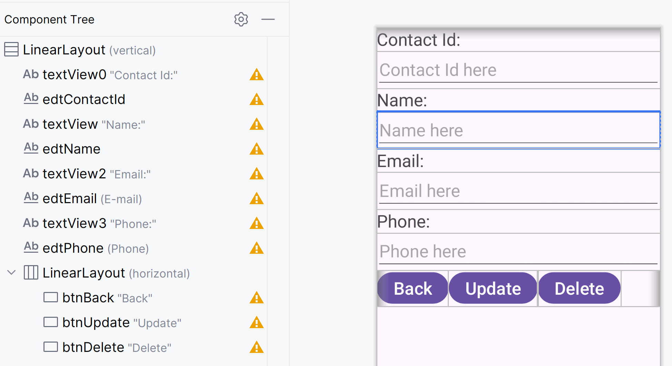
7. Read Single Data Firebase Realtime Database
DetailContactActivity

Slide 46
7. Read Single Data Firebase Realtime Database
MainActivity
private void addEvents() { lvContact.setOnItemClickListener(new AdapterView.OnItemClickListener() { @Override public void onItemClick(AdapterView<?> parent, View view, int position, long id) { String data=contactAdapter.getItem(position); String key=data.split("\n")[0]; Intent intent=new Intent(MainActivity.this,DetailContactActivity.class); intent.putExtra("KEY",key); startActivity(intent); } }); }

Slide 47
7. Read Single Data Firebase Realtime Database
DetailContactActivity
public class DetailContactActivity extends AppCompatActivity { EditText edtId,edtName,edtPhone,edtEmail; @Override protected void onCreate(Bundle savedInstanceState) { super.onCreate(savedInstanceState); setContentView(R.layout.activity_detail_contact); addViews(); getContactDetail(); } private void addViews() { edtId=findViewById(R.id.edtContactId); edtName=findViewById(R.id.edtName); edtPhone=findViewById(R.id.edtPhone); edtEmail=findViewById(R.id.edtEmail); }

Slide 48
7. Read Single Data Firebase Realtime Database
DetailContactActivity
private void getContactDetail() { Intent intent=getIntent(); final String key=intent.getStringExtra("KEY"); FirebaseDatabase database = FirebaseDatabase.getInstance(); DatabaseReference myRef = database.getReference("contacts"); myRef.child(key).addListenerForSingleValueEvent(new ValueEventListener() { @Override public void onDataChange(DataSnapshot dataSnapshot) { try { HashMap<String,Object> hashMap= (HashMap<String, Object>) dataSnapshot.getValue(); edtId.setText(key); edtName.setText(hashMap.get("name").toString()); edtEmail.setText(hashMap.get("email").toString()); edtPhone.setText(hashMap.get("phone").toString()); } catch (Exception ex) { Log.e("MY_ERROR",ex.toString()); } } @Override public void onCancelled(DatabaseError databaseError) { Log.w("MY_ERROR", "loadPost:onCancelled", databaseError.toException()); } }); }

Slide 49
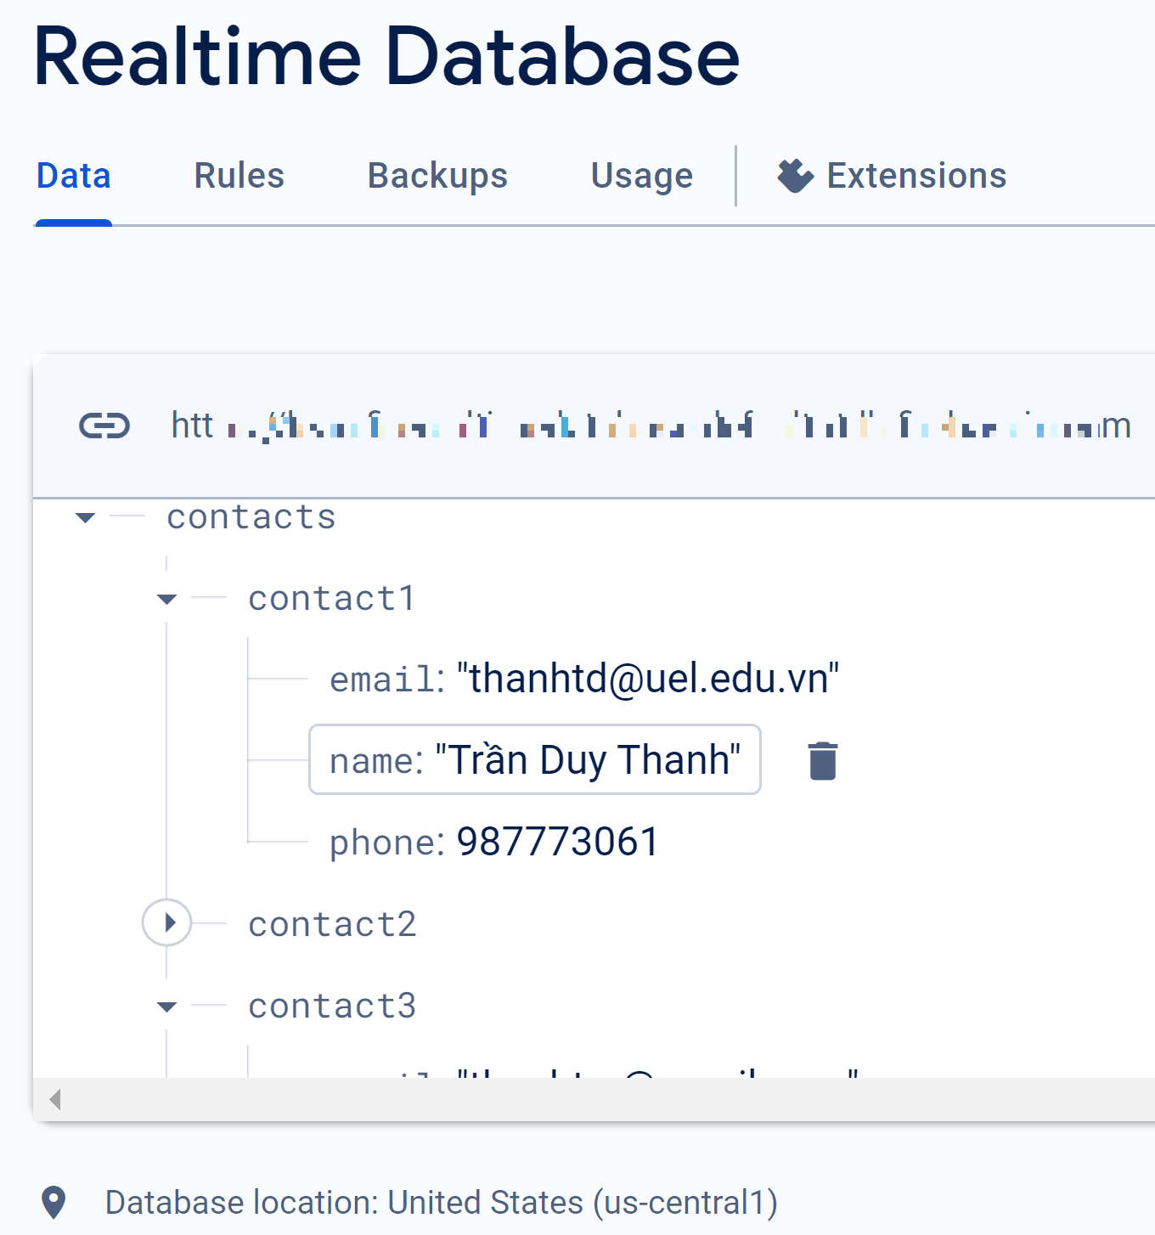
7. Read Single Data Firebase Realtime Database
touch
MainActivity
DetailContactActivity

Slide 50
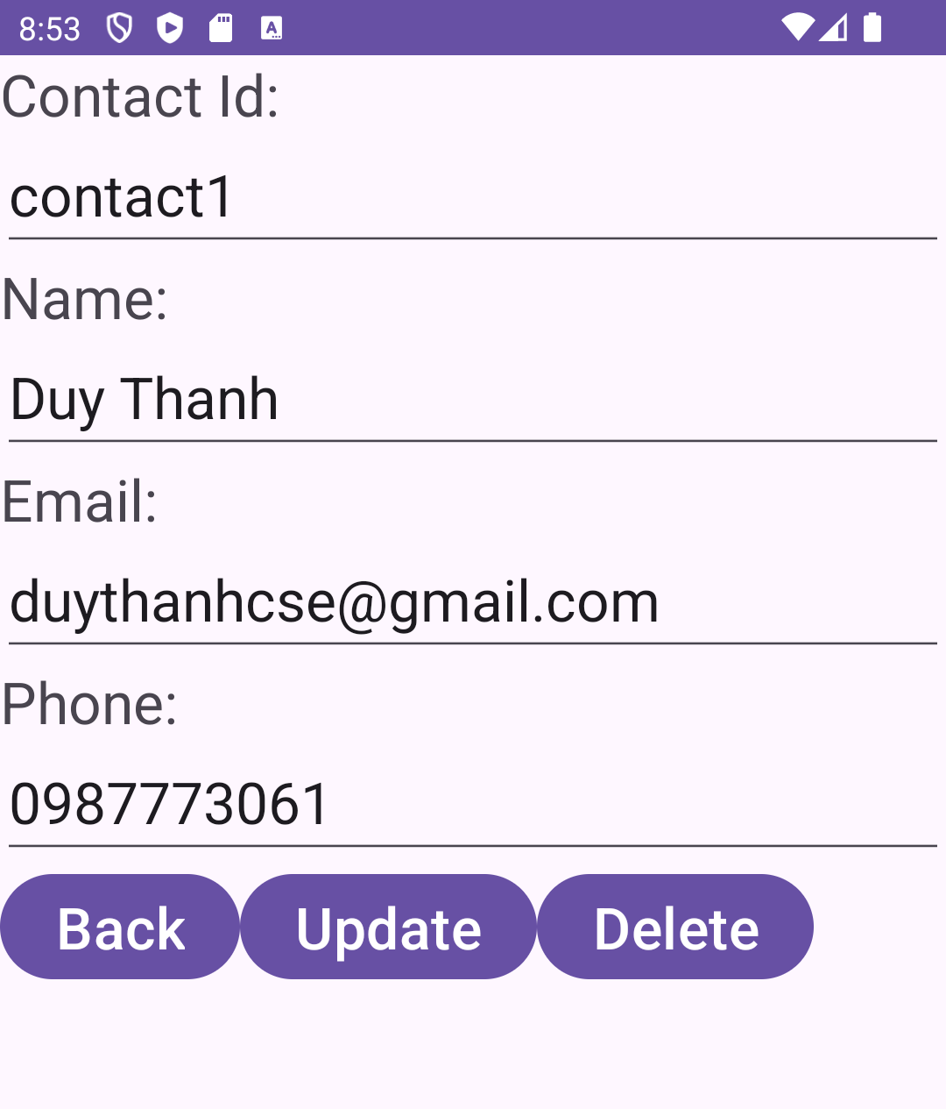
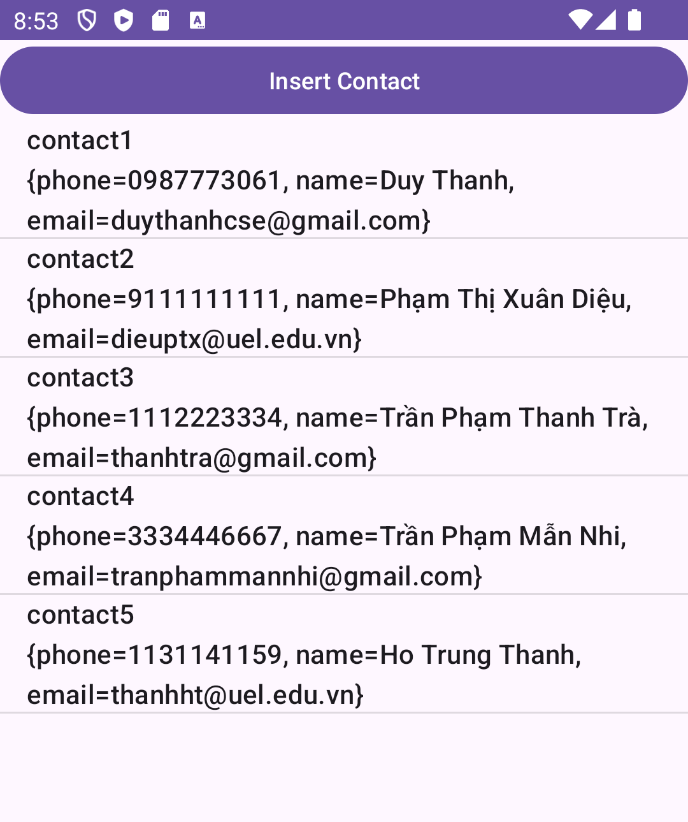
8. Update Firebase Realtime Database
MainActivity
DetailContactActivity
MainActivity

Slide 51
8. Update Firebase Realtime Database
DetailContactActivity
public void processUpdateContact(View view) { String key=edtId.getText().toString(); String phone=edtPhone.getText().toString(); String name=edtName.getText().toString(); String email=edtEmail.getText().toString(); FirebaseDatabase database = FirebaseDatabase.getInstance(); DatabaseReference myRef = database.getReference("contacts"); myRef.child(key).child("phone").setValue(phone); myRef.child(key).child("email").setValue(email); myRef.child(key).child("name").setValue(name); finish(); }

Slide 52
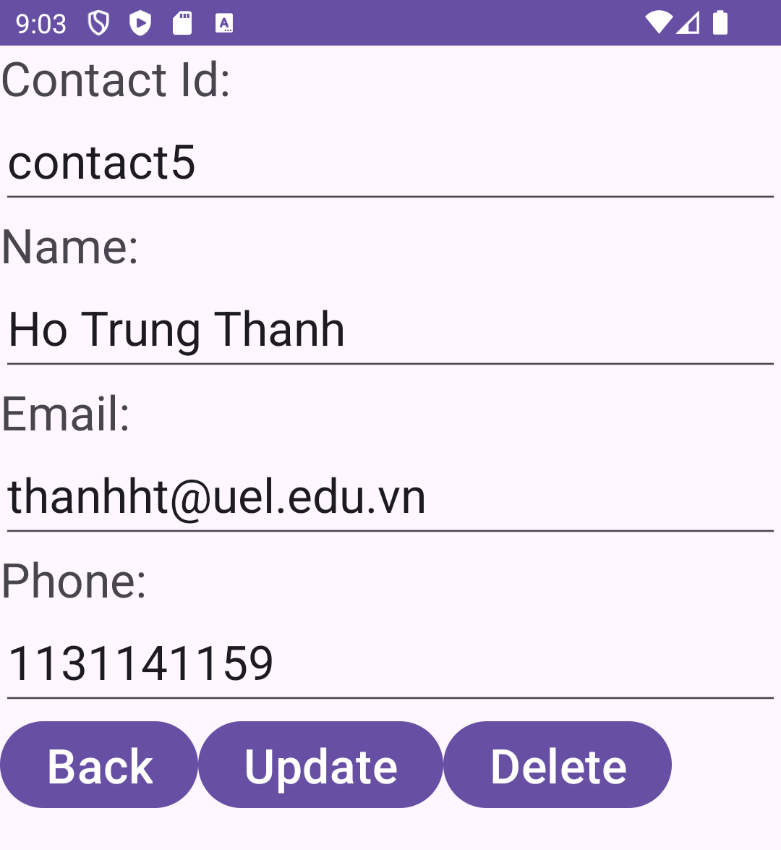
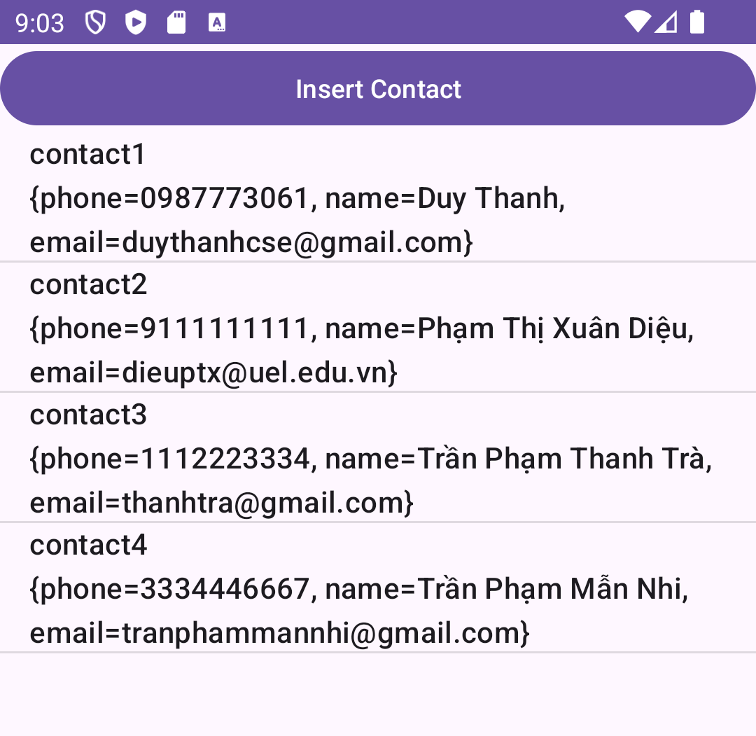
9. Delete Firebase Realtime Database
MainActivity
DetailContactActivity
MainActivity

Slide 53
9. Delete Firebase Realtime Database
DetailContactActivity
public void processDeleteContact(View view) { String key=edtId.getText().toString(); FirebaseDatabase database = FirebaseDatabase.getInstance(); DatabaseReference myRef = database.getReference("contacts"); myRef.child(key).removeValue(); finish(); }

Slide 54
Discussions
Q1: What are the advantages of Firebase Realtime Database?
Q2: How to create Firebase account?
Q3: How to connect Mobile to Firebase?
Q4: How to Select list data from Firebase Realtime Database?
Q5: How to Single data from Firebase Realtime Database?
Q6: How to Update data for Firebase Realtime Database?
Q7: How to Delete data from Firebase Realtime Database?

Slide 55
Next Lesson
Google Firebase Cloud Messaging

Slide 56
THANK YOU!

